Slide 1



About This Capstone
End-to-end automation capstone covering UI and API testing across three complete frameworks — built to industry standards with real-world practices.
SOFTWARE TESTING
Project 1 — Robot Framework
5 E2E UI scenarios, keyword-driven, DataDriver CSV, SeleniumLibrary, auto HTML reports.
CAPSTONE PROJECT
Project 2 — Pytest + Selenium
Three Complete Automation Frameworks
5 E2E UI scenarios, POM with 6 page classes, parametrize, conftest, step logging, HTML reports.
P1 — Robot Framework (E-Commerce UI)
P2 — Pytest + Selenium (E-Commerce UI)
Project 3 — Foodie App API
P3 — Foodie App (REST API Testing)
18 REST API endpoints across 5 modules tested with Pytest + Robot Framework + Postman.
Team Members
3
29+
18
6
Abhiramakrishna M
Thanmayi Gollavilli
Projects
Test Cases
API Endpoints
Team Members
Mohan Rupesh
Durga Prasad
Nishchaya Vishwakarma
Ranga Akash
🔗 UI Automation (RF + Pytest):
https://github.com/Abhiram4u/wipro_2026/tree/main/Capstone
🔗 Foodie App API Testing:
github.com/your-username/foodie-app-api-testing
IIHT | WIPRO FEB 2026 | CAPSTONE PROJECT

Slide 2
Agenda
Complete coverage — three projects, deep content, dedicated report & screenshot slides per framework
01
Project 1 — Robot Framework (UI)
Overview · Tech Stack · Folder Structure · 5 Scenarios · Keywords · Data-Driven · Report Screenshots
02
Project 2 — Pytest + Selenium (UI)
Overview · Tech Stack · Folder Structure · POM Classes · 6 Test Functions · conftest · Report Screenshots
03
Project 3 — Foodie App API
Flask Backend · 18 Endpoints · 5 Modules · Pytest Tests · Robot Framework Tests
04
RF Reports — Tests Passed
Robot Framework: tests passed screenshot placeholder — replace with your actual report.html screenshot
05
RF Reports — Log Report
Robot Framework: detailed log.html screenshot placeholder — replace with your actual log screenshot
06
Pytest Reports — Tests Passed
Pytest: tests passed HTML report screenshot — replace with your actual pytest-html report screenshot
07
Pytest Reports — Log Report
Pytest: detailed HTML log with step details — replace with your actual detailed report screenshot
08
Foodie API — Postman Screenshots
5 slides: Restaurant · Dish · Admin · User/Customer · Order module Postman collection screenshots
09
Foodie API — RF & Pytest Logs
Robot Framework foodie.robot log report + Pytest test_foodie.py log report screenshots
IIHT | WIPRO FEB 2026 | CAPSTONE PROJECT

Slide 3
Project Overview
All three capstone projects at a glance — type · tools & technologies · outcome
Project
Type
Tools & Technologies
Outcome
E-Commerce UI Automation Capstone
(Robot Framework)
UI Automation
Testing
SeleniumLibrary, Robot Framework,
DataDriver (CSV), Keyword-Driven,
Screenshot & Reporting
Developed an end-to-end keyword-driven automation framework covering registration, login, search, cart operations, and logout with reports and failure screenshots.
E-Commerce UI Automation Capstone
(Pytest Framework)
UI Automation
Testing
Selenium WebDriver, Pytest, POM,
Fixtures, Parameterization,
pytest-html / Allure
Built a scalable Page Object Model based automation suite with modular test cases, external configuration, data-driven execution, and custom HTML reporting.
Foodie App REST API Automation
API Automation
Testing
Flask REST API, Postman, Pytest,
Robot Framework (RequestsLibrary),
HTTP Status Validation
Automated validation of restaurant, dish, admin, and order APIs with reusable keyword-driven and data-driven API test suites.
IIHT | WIPRO FEB 2026 | CAPSTONE PROJECT

Slide 4
All 3 Projects — Overview & Comparison Table
Complete capstone overview: projects · frameworks · technologies · tools · test scope
Category
Project 1
Robot Framework (UI)
Project 2
Pytest + Selenium (UI)
Project 3
Foodie App (API)
Application
E-Commerce Site
(LambdaTest Playground)
E-Commerce Site
(LambdaTest Playground)
Foodie App
(Flask REST API — Local)
Framework
Robot Framework 6.x
Pytest 7.x
Pytest + Robot Framework
Language
Python 3 + Robot DSL
Python 3
Python 3
Browser / Client
Chrome (Selenium WebDriver)
Chrome / Firefox / Edge
requests library (HTTP)
Key Libraries
SeleniumLibrary
DataDriver
Robot Framework
selenium
pytest-html
configparser
requests
Robot RequestsLibrary
Flask
Design Pattern
Keyword-Driven + POM
(locators.robot)
Page Object Model
(6 POM page classes)
Request-Response Pattern
(18 endpoints)
Test Scenarios
5 E2E Scenarios
+ 1 Full Flow Suite
6 Test Functions
× 6 CSV rows = 36 runs
18 API Test Cases
(5 modules)
Data Strategy
CSV + DataDriver
(auto multi-run)
CSV + @parametrize
(test_data.csv)
Inline JSON payloads
in test functions
Reporting
report.html
log.html output.xml
report_HH-MM.html
(pytest-html plugin)
pytest -v terminal
RF log.html
Manual Testing
N/A
N/A
Postman Collection
(5 module runs)
IIHT | WIPRO FEB 2026 | CAPSTONE PROJECT

Slide 5
PROJECT 01
E-Commerce UI Automation
Selenium WebDriver + Robot Framework + Python

Slide 6






Project 1 — Project Objective
Understanding the purpose, scope, and goals of the Robot Framework automation project
What is this project?
Quick Facts
Application Under Test
This project involves building a complete keyword-driven UI automation framework for an E-Commerce web application using Selenium WebDriver with Robot Framework. The framework automates five critical end-to-end user journeys — from registration and login through product search, cart management, and session logout.
E-Commerce Playground
(LambdaTest Demo Site)
Test Framework
Robot Framework 6.x
Browser Automation
Primary Goal
Automate 5 real-world E2E test scenarios on a live e-commerce site using keyword-driven testing
Selenium WebDriver (Chrome)
Test Scenarios
5 Scenarios + 1 E2E Suite
Design Pattern
Page Object Model — locators.robot centralizes all element IDs so tests never interact with Selenium directly
Data-Driven Library
DataDriver (CSV format)
Data Strategy
CSV-driven via DataDriver Library — one test template runs for every row of test data automatically
Execution Command
robot -d reports tests/
Quality Goals
Explicit waits, screenshot on failure, modular keywords, meaningful assertions in every test case
Report Format
report.html + log.html
Deliverables
HTML report.html + log.html generated after every run, Git repository with proper README documentation
Screenshot on Fail
Auto-captured via Test Teardown
IIHT | WIPRO FEB 2026 | CAPSTONE PROJECT — Project 1: Robot Framework

Slide 7





Project 1 — Overview & Technology Stack
Keyword-driven, data-driven, modular UI automation for a live e-commerce application
5
13
4
1
Test Suites
(TC01–TC05)
Total Robot
Files
CSV Data
Files
E2E Full
Flow Suite
Python 3
All automation logic, data handling, and keyword implementations are written in Python.
Core Language
Robot Framework
Provides keyword-driven syntax, lifecycle management (Setup/Teardown), and auto HTML report generation.
Test Runner & Orchestrator
Selenium WebDriver
Controls Chrome/Firefox browser — clicks, inputs, navigates just like a real user would do.
Browser Automation Engine
SeleniumLibrary
Ready-made keywords: Click Element, Input Text, Wait Until Element Is Visible, Capture Page Screenshot.
Robot–Selenium Bridge
DataDriver Library
Reads CSV rows and re-runs the same test case automatically for each row — zero code duplication.
Data-Driven Execution
IIHT | WIPRO FEB 2026 | CAPSTONE PROJECT — Project 1: Robot Framework

Slide 8
Project 1 — Folder Structure & Framework Architecture
Every folder has a single responsibility — modular, scalable, and maintainable
📁 robot-framework/
tests/
📂 tests/
5 individual test suites + 1 full E2E suite. Each imports its keyword file and uses DataDriver for CSV execution.
tc01_register_login.robot
tc02_search_product.robot
tc03_add_to_cart.robot
keywords/
tc04_cart_update_remove.robot
7 reusable keyword files — one per feature. Keyword definitions live here, never inside test files.
tc05_logout.robot
tc0_endtoend_flow.robot
📂 keywords/
resources/
register.robot | login.robot
search.robot | cart.robot
common.robot: browser open/close + screenshot teardown. locators.robot: every element locator centralized.
logout.robot | product.robot
📂 resources/
common.robot | locators.robot
variables/
email_generator.robot
testdata.robot stores BASE_URL, browser, waits. CSV files hold multi-row test data for DataDriver.
📂 variables/
testdata.robot | *.csv files
📂 reports/
reports/
report.html | log.html | *.png
Auto-generated after every run: report.html (summary dashboard), log.html (detailed steps), output.xml.
IIHT | WIPRO FEB 2026 | CAPSTONE PROJECT — Project 1: Robot Framework

Slide 9





Project 1 — 5 End-to-End Test Scenarios
Each scenario is data-driven via CSV — executes automatically once per row — zero code duplication
TC01
TC02
TC03
TC04
TC05
User Registration
& Login
Product Search
& Details
Add to
Cart
Update Cart
& Remove
Logout &
Session
📊 register_data.csv
📊 search_data.csv
📊 search_data.csv
📊 search_data.csv
📊 login_data.csv
Data-Driven Run
Data-Driven Run
Data-Driven Run
Data-Driven Run
Data-Driven Run
1
Navigate to Register page
1
Open home page
1
All TC02 steps
1
All TC03 steps
1
Login with CSV credentials
2
Fill form: name, phone, password
2
Clear & type product name
2
Wait for product page
2
Open Shopping Cart
2
Assert My Account loaded
3
Generate unique dynamic email
3
Verify typed text in box
3
Check Add to Cart visible
3
Update quantity to 2
3
Click My Account dropdown
4
Submit & assert 'Account Created'
4
Press ENTER to search
4
Check button is enabled
4
Click Update Cart
4
Click Logout link
5
Logout completely
5
Assert search results appear
5
Click Add to Cart button
5
Assert update message
5
Assert Logout page title
6
Login with new credentials
6
Click first product card
6
Assert success toast message
6
Click Remove button
6
Assert URL has route=logout
7
Assert My Account page
7
Assert product detail URL
7
Assert View Cart button
7
Assert cart is empty
7
Session fully terminated
IIHT | WIPRO FEB 2026 | CAPSTONE PROJECT — Project 1: Robot Framework

Slide 10
Project 1 — Team Presentation Assignments
Robot Framework Team: 3 members · each explains their assigned module to the trainer
🤖 Robot Framework Team — Who Presents What
👤
🔍
🛒
Abhiramakrishna M
Thanmayi Gollavilli
Mohan Rupesh
Module 1 — User Registration & Login
Module 2 — Product Search & Product Details
Module 3 — Add to Cart · Update Cart · Remove · Logout
tc01_register_login.robot test suite
tc02_search_product.robot test suite
Add to Cart — add_to_cart.robot
Walk through Register page automation steps
Walk through search box automation & product selection
Explain TC04: Cart Update & Remove — cart_update_remove.robot
Show dynamic email generation using email_generator.robot
Show search_data.csv driving 3 different product searches
Explain TC05: Session Logout — tc05_logout.robot
Explain CSV data from register_data.csv (3 user rows)
Explain locators.robot — how search & product locators are defined
Show Defensive keyword: Run Keyword And Return Status for out-of-stock
Demonstrate Login keyword flow after registration
Demonstrate keyword: Search Product, Verify Product Page
Walk through tc0_endtoend_flow.robot — the full E2E suite
Show report.html → pass results for TC01
Show log.html → step-by-step search execution
Show combined report.html — all 5 suites passing
IIHT | WIPRO FEB 2026 | CAPSTONE PROJECT — Project 1: Robot Framework

Slide 11



Project 1 — Keywords, Resources & Automation Concepts
common.robot · locators.robot · keyword-driven design · 6 key automation practices
common.robot
locators.robot
6 Key Automation Concepts
Shared lifecycle — imported by all suites
All element locators in one file
Page Object Model
Open Site
Suite Setup
id=
Email, password, phone, confirm password fields — unique HTML id attributes
Locators separated from actions — tests never touch Selenium directly
Opens browser, navigates to BASE_URL, maximizes window, sets 10s implicit timeout. Runs once before all tests.
id=input-email
Keyword-Driven
Human-readable steps — Click Element, Input Text, no raw code in tests
name=
Search box on home page — using name attribute value
Data-Driven
Close Site
Suite Teardown
name=search
DataDriver + CSV: one template runs for every row automatically
Closes browser cleanly after all tests complete. Ensures no zombie browser windows remain open.
Explicit Waits
xpath=
Navigation links, page headings, labels — flexible path expressions
Wait Until Element Is Visible before every action — handles slow loads
xpath=//a[@href*='login']
Defensive Testing
Take Screenshot
On Failure
Test Teardown
Run Keyword And Return Status handles out-of-stock items gracefully
Runs after every test. Captures a timestamped PNG at the exact moment of failure and attaches to log.html.
css=
Submit buttons via CSS class selectors — short and reliable
Screenshot on Fail
css=input.btn-primary
Test Teardown captures browser screen at exact failure moment
💡 Change only locators.robot when the site updates — tests stay intact.
IIHT | WIPRO FEB 2026 | CAPSTONE PROJECT — Project 1: Robot Framework

Slide 12
Project 1 — Data-Driven Testing with CSV Files
One test template · DataDriver reads CSV · runs once per row · multiple results automatically
CSV File
(Data Source)
DataDriver
Reads Rows
Test Runs
Once Per Row
Multiple Results
Automatically
→
→
→
📊 register_data.csv
📊 search_data.csv
firstname
lastname
email
phone
password
HP LP3065
Abhi
Ram
abhi_{rand}@gmail.com
9876543210
Test@123
Nikon D300
iMac
Ranga
Akash
akash_{rand}@test.com
9123456789
Akash@123
📊 login_data.csv
Durga
Prasad
dp_{rand}@mail.com
9988776655
Prasad@123
user1@test.com / Pass1
user2@test.com / Pass2
user3@test.com / Pass3
Execution Command & Report Output
robot -d reports tests/
robot tests/tc01_register_login.robot
📄 report.html — Summary dashboard (pass/fail counts, duration)
📋 log.html — Step-by-step execution with screenshots
📁 output.xml — Machine-readable for CI/CD integration
IIHT | WIPRO FEB 2026 | CAPSTONE PROJECT — Project 1: Robot Framework

Slide 13
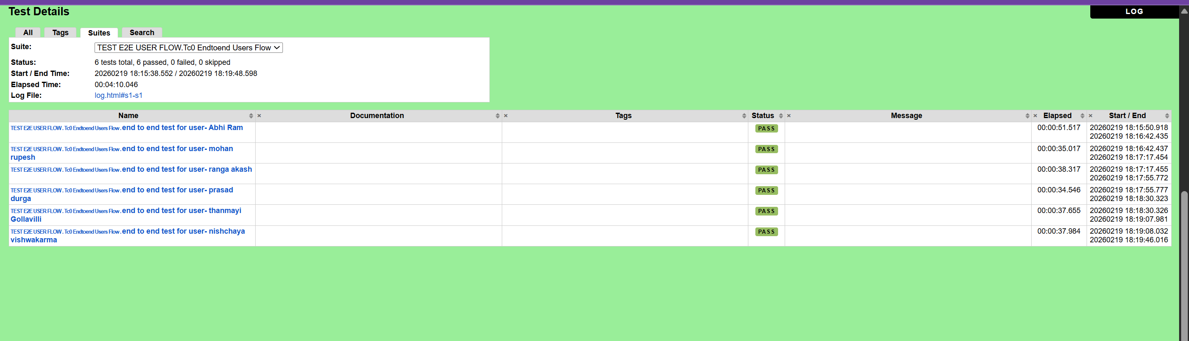
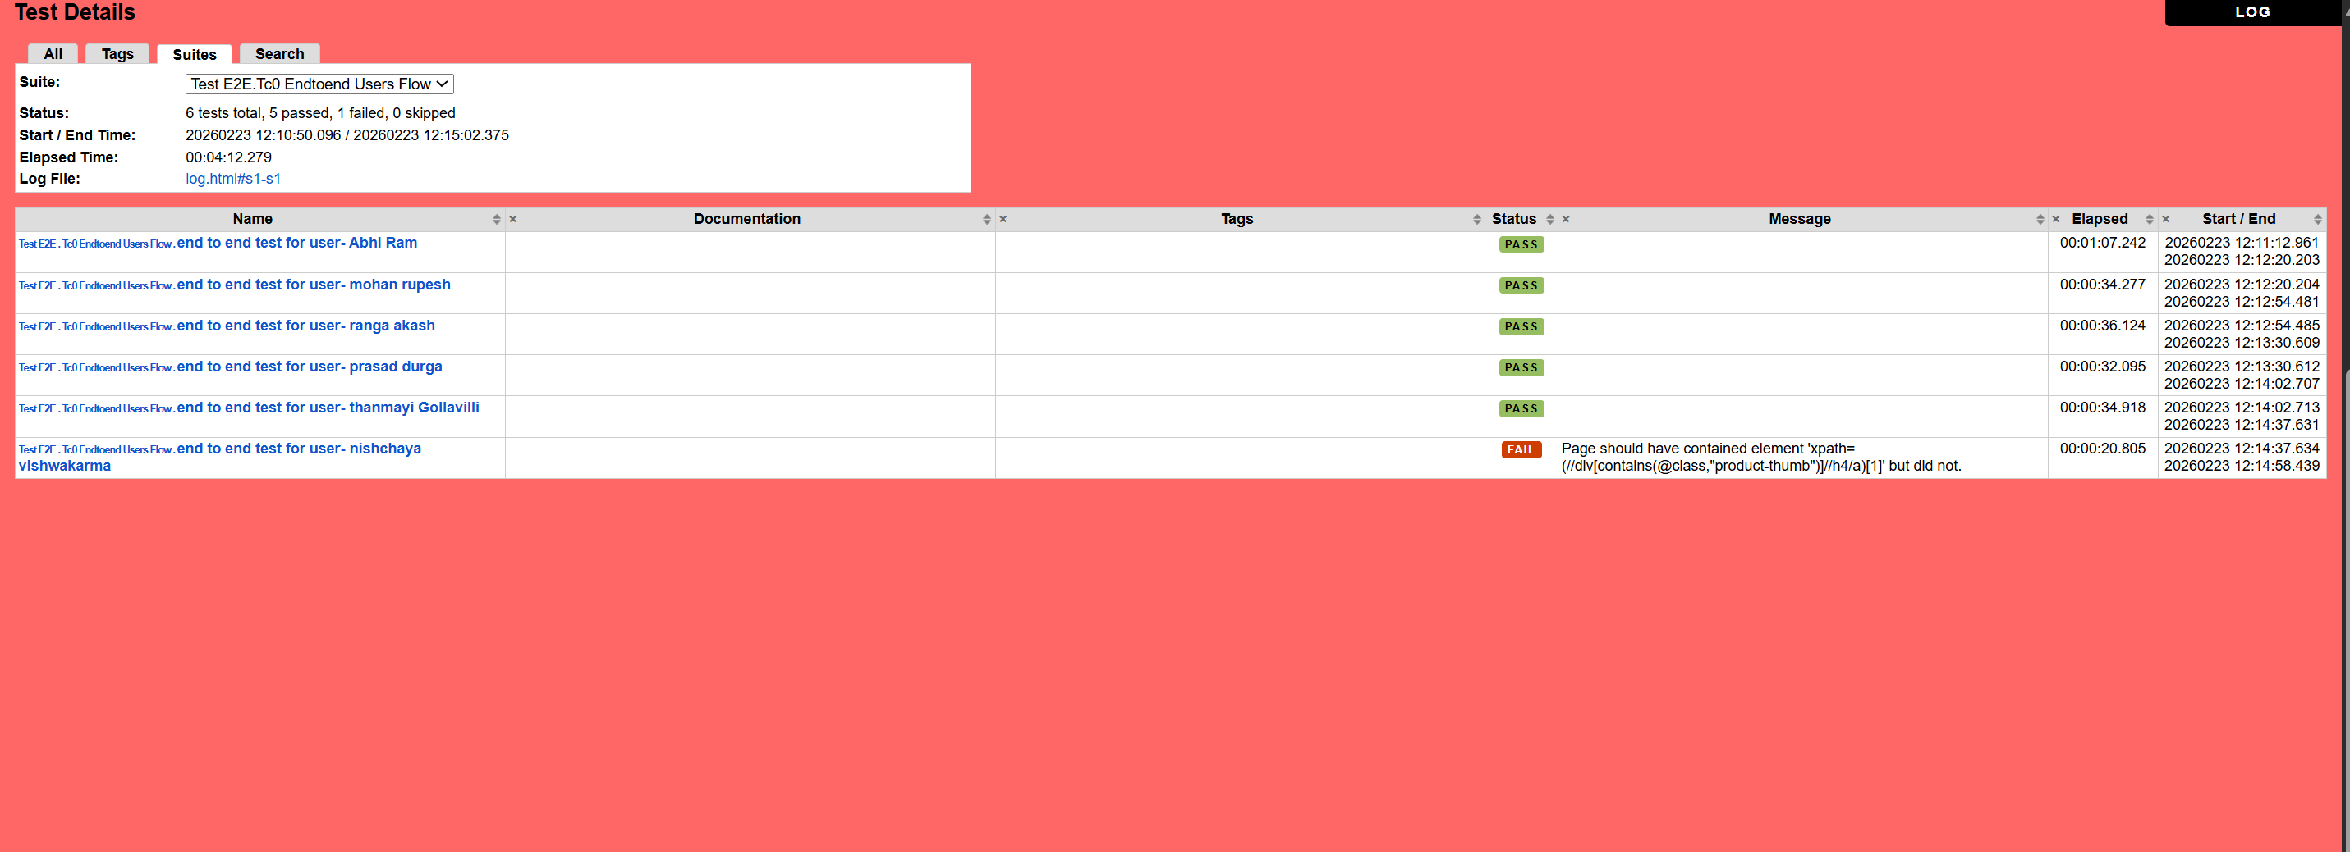
Project 1 — Robot Framework | Tests Passed Screenshot For End to End Users
📌 How to replace: Open report.html in browser → take a full-page screenshot → paste it here (click placeholder → Format Picture → Fill → Picture)
RF report.html
screenshot placeholder
📷
[ Replace with actual screenshot ]
Robot Framework — Tests Passed (report.html)
Shows: Total tests run · Passed count · Failed count · Duration · Suite-level results
IIHT | WIPRO FEB 2026 | CAPSTONE PROJECT — Project 1: Robot Framework

Slide 14
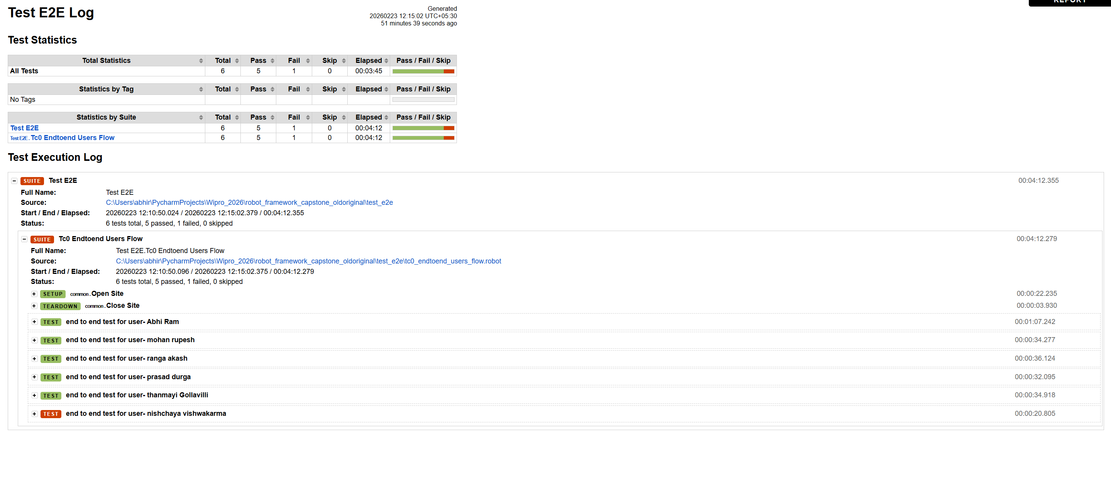
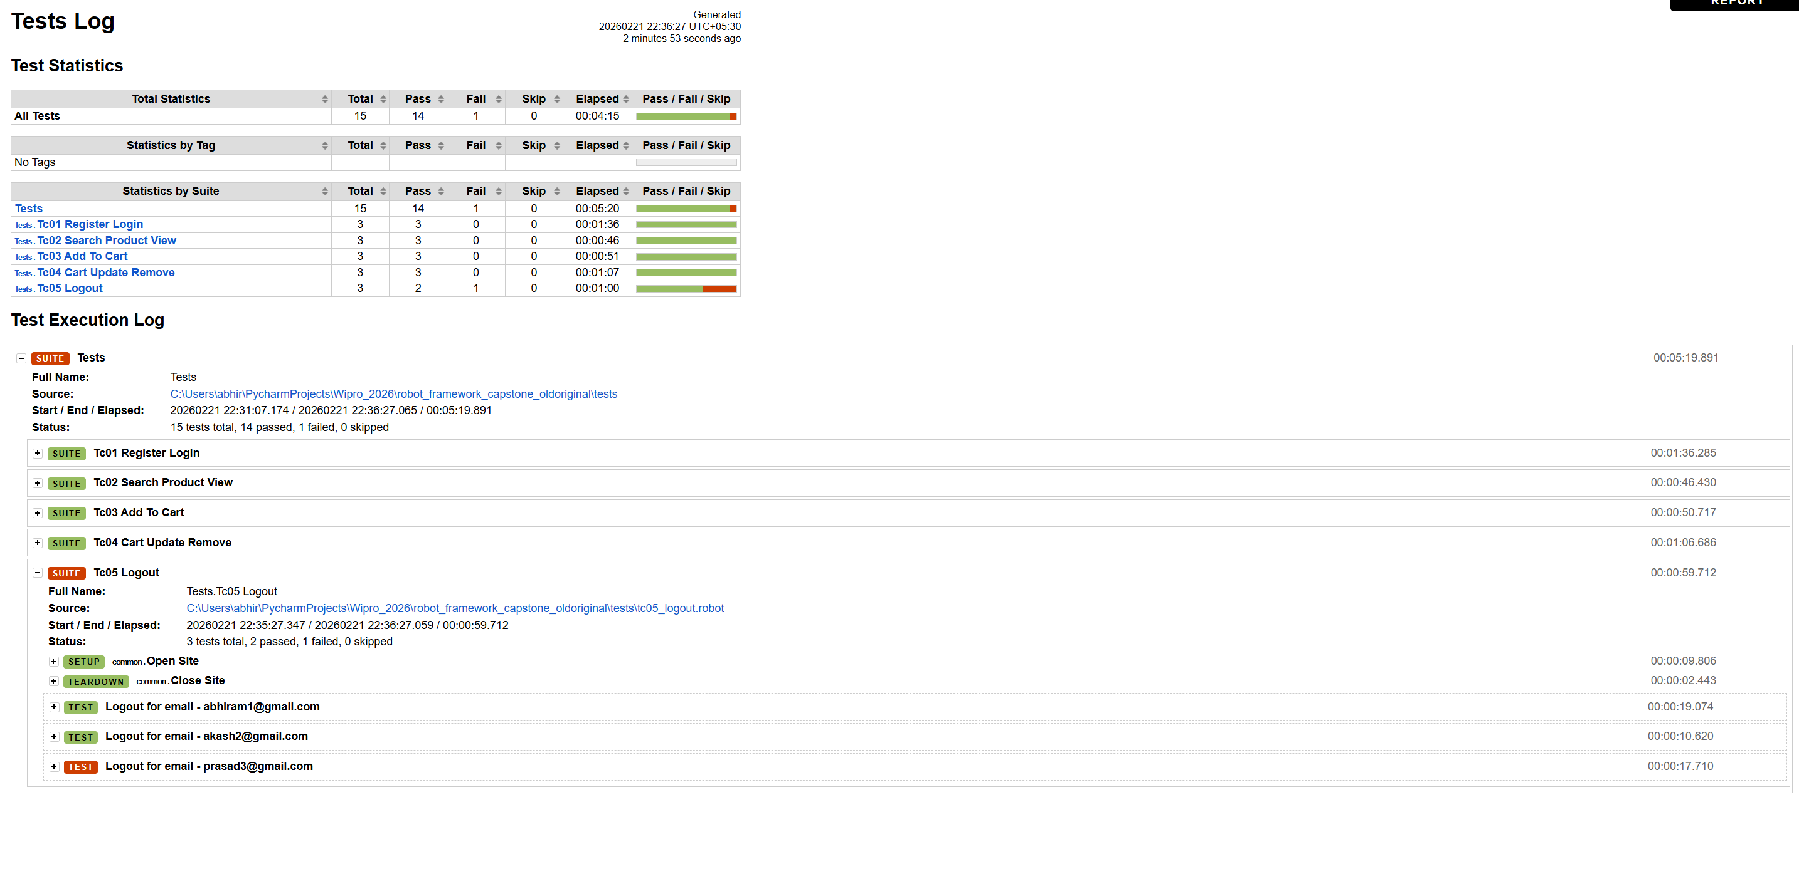
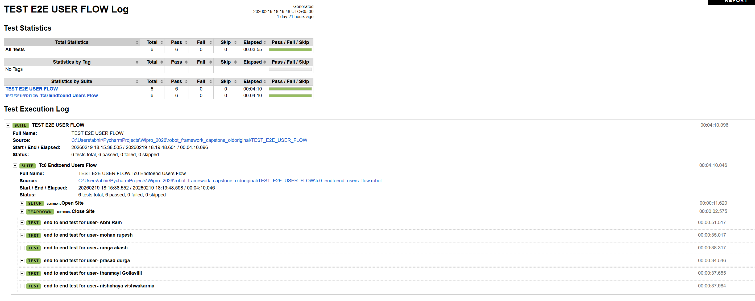
Project 1 — Robot Framework | Log Report Screenshot
📌 How to replace: Open log.html in browser → expand keyword tree → take screenshot → paste here
RF log.html
screenshot placeholder
📷
[ Replace with actual screenshot ]
Robot Framework — Log Report (log.html)
Shows: Keyword-level steps · Pass/Fail per step · Timestamps · Embedded screenshots for failures
IIHT | WIPRO FEB 2026 | CAPSTONE PROJECT — Project 1: Robot Framework

Slide 15
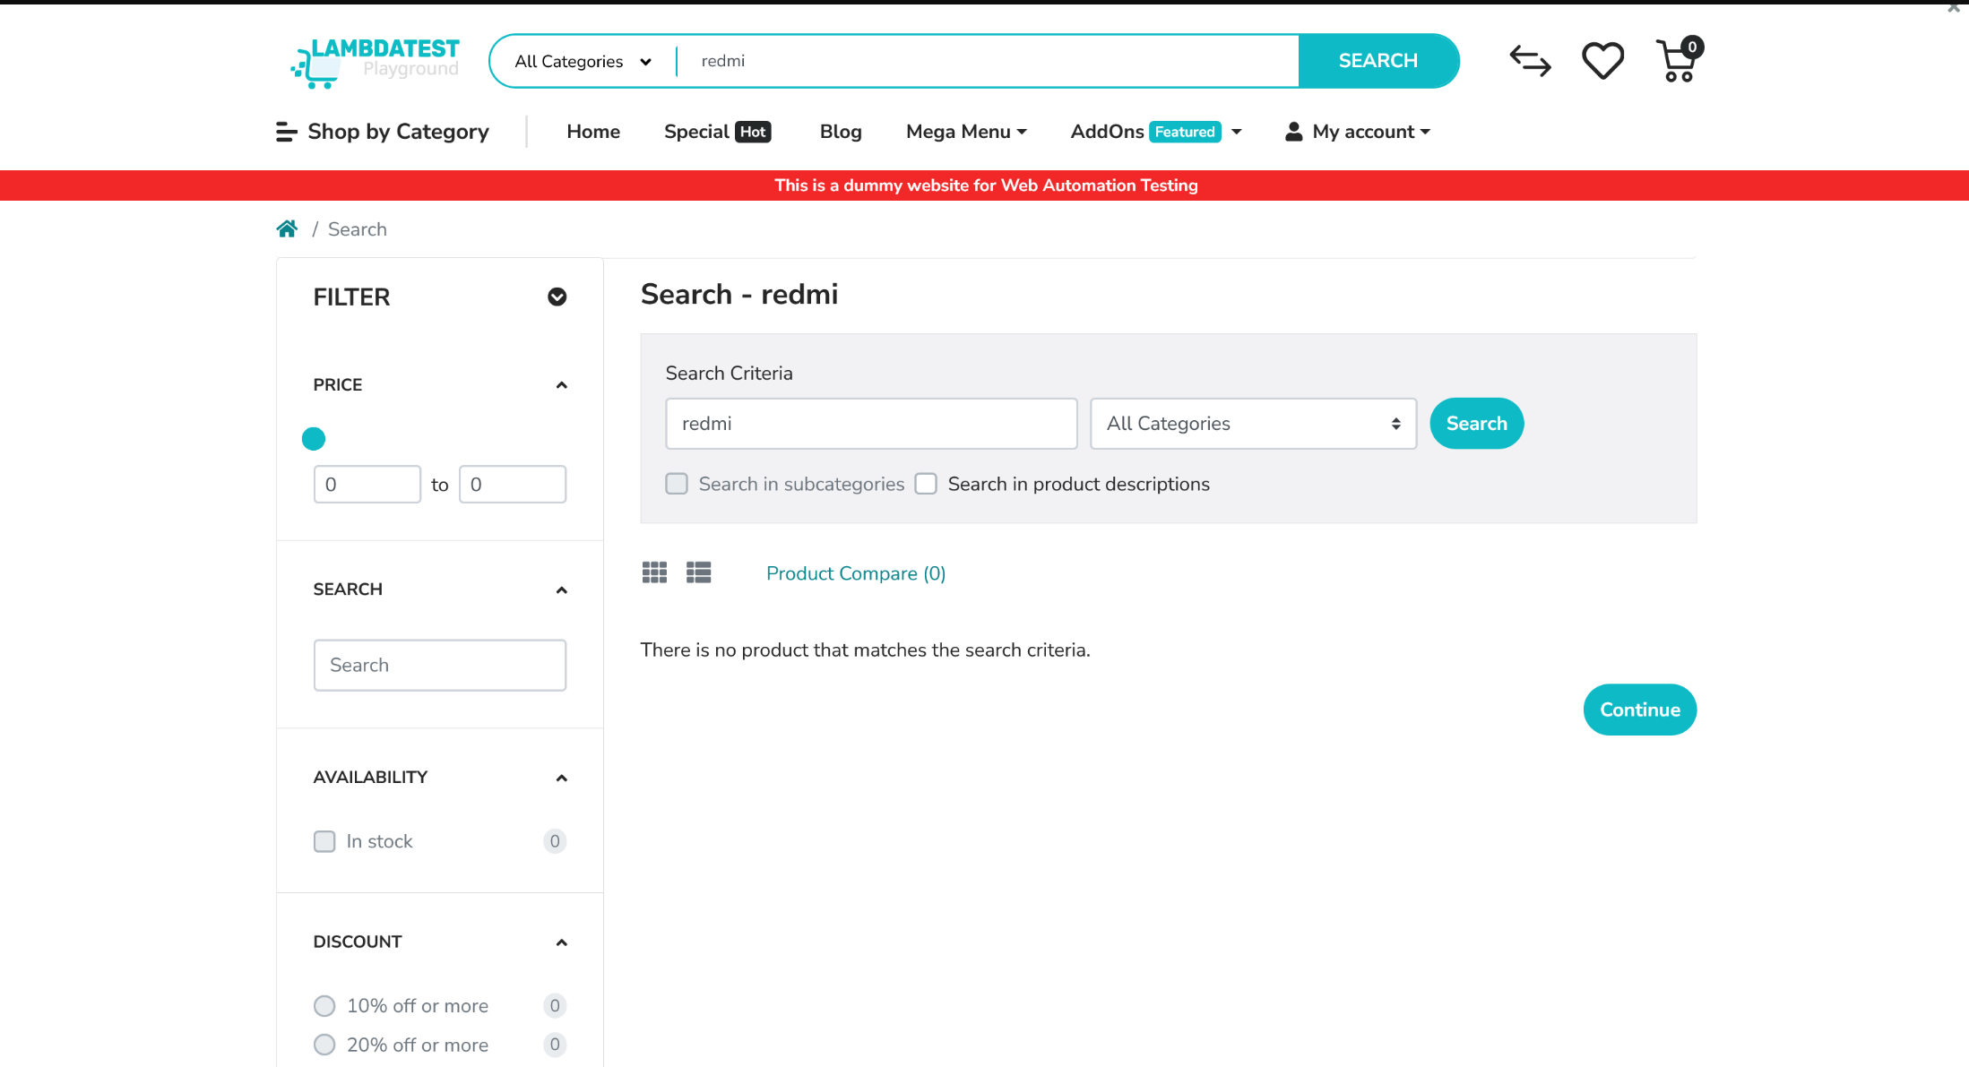
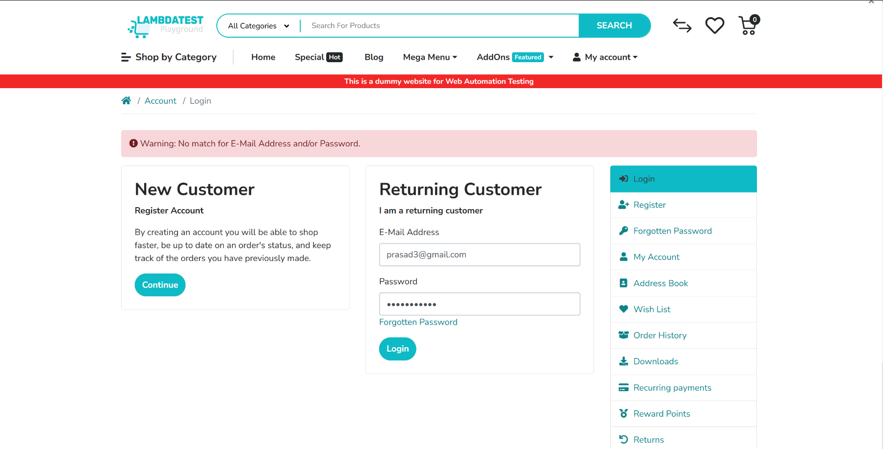
FAILED TEST CASE - WebPage Screenshot

Slide 16
Project 1 — Challenges Faced
Robot Framework
Real problems we encountered and how we solved them
01
📧
Dynamic Email — Duplicate Registration Error
02
🛒
Out-of-Stock Product — Add to Cart Fails
⚠ Problem
⚠ Problem
Running the same test multiple times caused 'Email already registered' errors because we used a fixed email in the CSV.
Some products on the e-commerce site were out of stock, causing Click Element on 'Add to Cart' to throw ElementNotFoundException and fail the test.
✔ Solution
✔ Solution
Created email_generator.robot keyword that generates a unique email each run using a timestamp — e.g. user_20260222_143022@test.com
Used 'Run Keyword And Return Status' to check if the button exists. If out-of-stock, the test logs a warning and skips cart steps gracefully without failing.
03
⏱️
Slow Page Load — Element Not Found Too Early
04
🔍
Locator Breakage — Element IDs Changed
⚠ Problem
⚠ Problem
Tests were clicking on elements before the page fully loaded, causing intermittent failures especially on the cart and product detail pages.
During development, web element IDs on the registration form changed, breaking 3 test suites at once.
✔ Solution
✔ Solution
Replaced all Sleep keywords with 'Wait Until Element Is Visible' with a 15-second timeout — tests now wait exactly as long as needed, no more, no less.
Because all locators were centralized in locators.robot (POM principle), we fixed all 3 suites by updating just ONE file — demonstrating the real value of POM design.
IIHT | WIPRO FEB 2026 | CAPSTONE PROJECT — Project 1: Robot Framework

Slide 17
PROJECT 02
E-Commerce UI Automation
Selenium WebDriver + Pytest + Page Object Model

Slide 18
Project 2 — Project Objective
Understanding the purpose, scope, and goals of the Pytest + Selenium automation project
What is this project?
Quick Facts
Application Under Test
This project builds a professional Page Object Model (POM) based UI automation framework using Selenium WebDriver with Pytest. It automates the same five E-Commerce end-to-end scenarios using a Python-class-driven approach with parametrized test data, a shared conftest.py driver fixture, automatic HTML reporting, and screenshot capture on every test failure.
E-Commerce Playground (LambdaTest)
Test Framework
Pytest 7.x + pytest-html plugin
Browser Automation
Primary Goal
Automate 5 real-world E2E UI scenarios using Pytest with POM — modular, reusable, and CI-ready
Selenium WebDriver (Chrome/Firefox/Edge)
Design Pattern
Page Object Model (POM)
Design Pattern
POM with 6 page classes (BasePage + 5 feature pages) — all locators and actions encapsulated
Configuration
config.ini (browser, URL, wait=15s)
Data Strategy
@pytest.mark.parametrize + test_data.csv: 6 functions × 6 rows = 36 total test executions per run
Test Data
test_data.csv — 6 user rows
Quality Goals
Multiple assertions per test, step() logging, screenshot embedded in HTML report on failure
Execution Command
pytest -v --html=reports/report.html
Deliverables
Timestamped report_HH-MM-SS.html + screenshots/ folder + Git repo with proper documentation
Screenshot on Fail
Auto-embedded in HTML report via hook
IIHT | WIPRO FEB 2026 | CAPSTONE PROJECT — Project 2: Pytest + Selenium

Slide 19
Project 2 — Overview & Technology Stack
POM-based, parametrized, CI-ready Pytest automation with custom HTML reporting
6
6
6
3
Test Functions
(test_01–test_06)
POM Page
Classes
CSV Data
Rows (Users)
Browsers
Supported
Python 3
All page objects, fixtures, hooks, and test logic written in clean Python following PEP8 standards.
Core Language
Selenium WebDriver
Controls Chrome/Firefox/Edge — interacts with the browser exactly like a real end user would.
Browser Automation Engine
Pytest
Test discovery, fixture injection, parametrize decorator, hooks for reporting and screenshot capture.
Test Framework & Runner
pytest-html
Generates timestamped report_HH-MM-SS.html with embedded screenshots, step logs, and pass/fail.
HTML Report Generator
configparser + CSV
config.ini externalizes browser/URL/wait settings. test_data.csv holds 6 user rows for parametrize.
Config & Data Management
IIHT | WIPRO FEB 2026 | CAPSTONE PROJECT — Project 2: Pytest + Selenium

Slide 20
Project 2 — Folder Structure & conftest.py
Clean separation of concerns — each folder owns one responsibility
📁 pytest-framework/
conftest.py — Framework Brain
📂 config/
config.ini (browser, url, wait=15)
driver fixture (scope='class')
📂 data/
Reads browser from config.ini or --browser CLI. Creates Chrome/Firefox/Edge WebDriver, opens BASE_URL, maximizes. Yields driver to tests. Quits after all tests in class complete.
test_data.csv (6 user rows)
📂 pages/
step() fixture (scope='function')
base_page.py
Accepts a step description string. Logs it to terminal AND appends to pytest-html report so every action is visible in the HTML output file.
login_page.py
search_page.py
pytest_runtest_makereport
product_page.py
cart_page.py
Hook runs after every test. On FAIL or SKIP: saves timestamped PNG to screenshots/ folder, encodes as base64, embeds inline in HTML report automatically.
account_page.py
📂 tests/
pytest_configure
conftest.py
Creates reports/ and screenshots/ directories on startup. Generates timestamped filename: report_14-32-55.html so each run preserves its own report.
test_ecommerce.py
📂 utilities/
pytest_collection_modifyitems
utils.py (get_csv_data)
Sorts collected tests by parametrize ID then test name. Ensures data0-test01, data0-test02… data1-test01 order so class-scoped driver stays alive per user.
📂 reports/ + screenshots/
report_HH-MM-SS.html | *.png
pytest.ini
pytest_addoption
Adds --browser CLI argument. Lets you run: pytest --browser=firefox to override config.ini without editing any source file.
IIHT | WIPRO FEB 2026 | CAPSTONE PROJECT — Project 2: Pytest + Selenium

Slide 21
Project 2 — 6 Test Functions & Page Object Classes
@pytest.mark.parametrize × 6 CSV rows = 36 total test executions per run
test_ecommerce.py — 6 Test Functions
6 POM Page Classes
test_01_invalid_login
BasePage
Login with random invalid email + password. Asserts warning message visible. Uses step() to log each sub-action.
find_element, click, send_keys, is_visible, js_click — all use explicit 15s WebDriverWait
test_02_registration
LoginPage
Fills registration form using CSV data. Generates unique email with {random} placeholder. Asserts success message.
navigate_to_login, login, data_register, get_registration_success_message
test_03_logout_login
SearchPage
Logs out post-registration. Logs back in with newly registered credentials. Asserts Logout link visible in nav.
search_product (form.submit()), select_product (first result click)
test_04_search_and_add
ProductPage
Searches product from CSV. Selects first result. Calls add_to_cart_with_handling — handles success/out-of-stock/error.
add_to_cart_with_handling → returns 'success' / 'out_of_stock' / 'error'
test_05_cart_management
CartPage
Navigates to cart (15s wait + scroll). Updates quantity from CSV. Removes item. Asserts empty cart message. Skips if no cart item.
navigate_to_cart (popup wait + scroll + edit cart), edit_quantity, remove_item
test_06_logout
AccountPage
Final logout via My Account dropdown. Asserts 'Account Logout' title. Handles session-already-expired edge case gracefully.
logout, is_logged_in (Logout link check), is_logged_out (title check)
IIHT | WIPRO FEB 2026 | CAPSTONE PROJECT — Project 2: Pytest + Selenium

Slide 22
Project 2 — Team Presentation Assignments
Pytest + Selenium Team: 3 members · each explains their assigned module to the trainer
🐍 Pytest + Selenium Team — Who Presents What
👤
🔍
🛒
Durga Prasad
Nishchaya Vishwakarma
Ranga Akash
Module 1 — User Registration & Login
Module 2 — Product Search & Product Details
Module 3 — Cart Management · Update · Remove · Logout
Explain test_01_invalid_login — negative test with assertion
Explain test_03_logout_login — login with registered credentials
Explain test_05_cart_management — update qty, remove, empty assert
Explain test_02_registration — form fill + dynamic email generation
Explain test_04_search_and_add — search + product selection
Explain test_06_logout — dropdown click + logout validation
Walk through LoginPage class: navigate_to_login, data_register
Walk through SearchPage class: search_product, select_product
Walk through CartPage: navigate_to_cart (15s wait + scroll)
Show test_data.csv — how user rows drive parametrize decorator
Walk through ProductPage: add_to_cart_with_handling (3 outcomes)
Walk through AccountPage: logout, is_logged_in, is_logged_out
Demonstrate step() function logging inside test functions
Show conftest.py driver fixture — class scope explained
Show screenshot capture hook — failure PNG embedded in HTML
Show pytest HTML report showing pass for registration/login tests
Show HTML report — step logs for search & product tests
Show final complete HTML report — all 36 parametrized tests passed
IIHT | WIPRO FEB 2026 | CAPSTONE PROJECT — Project 2: Pytest + Selenium

Slide 23
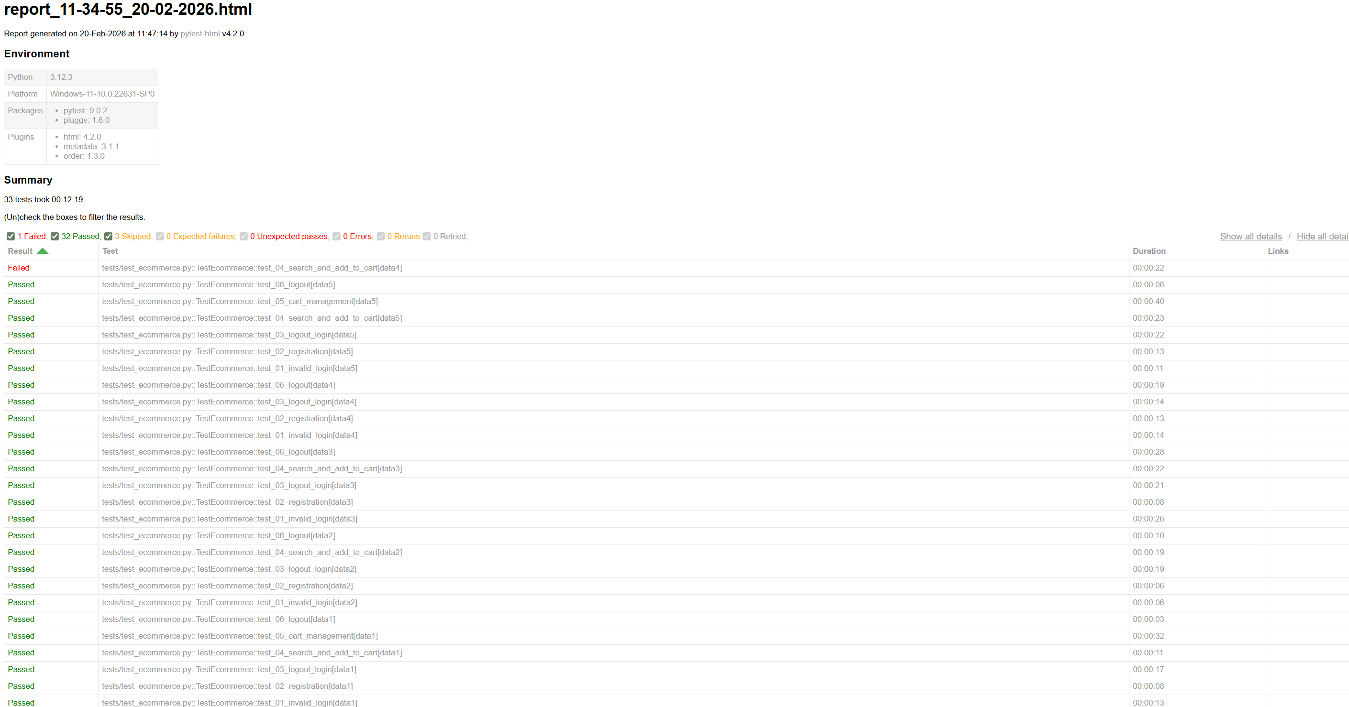
Project 2 — Pytest | Log Report Screenshot
📌 How to replace: Open the same HTML report → scroll to a test → expand the log steps section → screenshot → paste here
Pytest Log
screenshot placeholder
📷
[ Replace with actual screenshot ]
Pytest — Log Report (step-by-step details)
Shows: step() logs per test · failure reason · embedded PNG screenshot inside the HTML
IIHT | WIPRO FEB 2026 | CAPSTONE PROJECT — Project 2: Pytest + Selenium

Slide 24
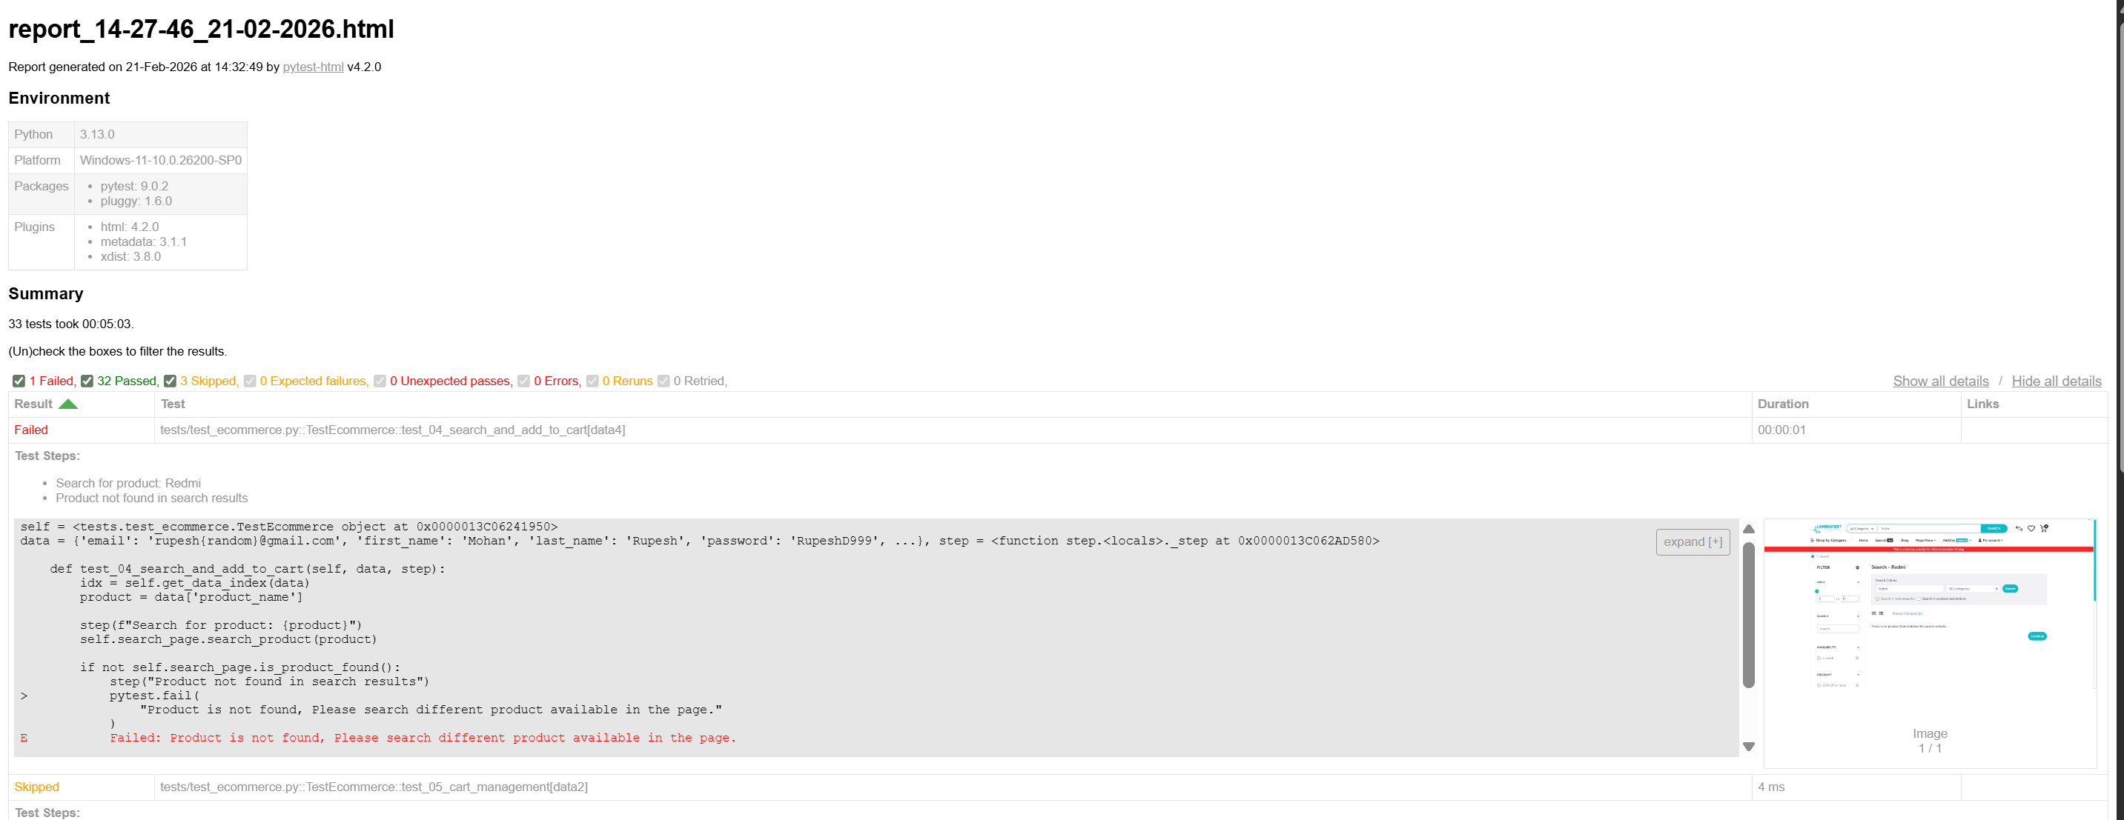
Project 2 — Pytest | Failed Log Report Screenshot

Slide 25
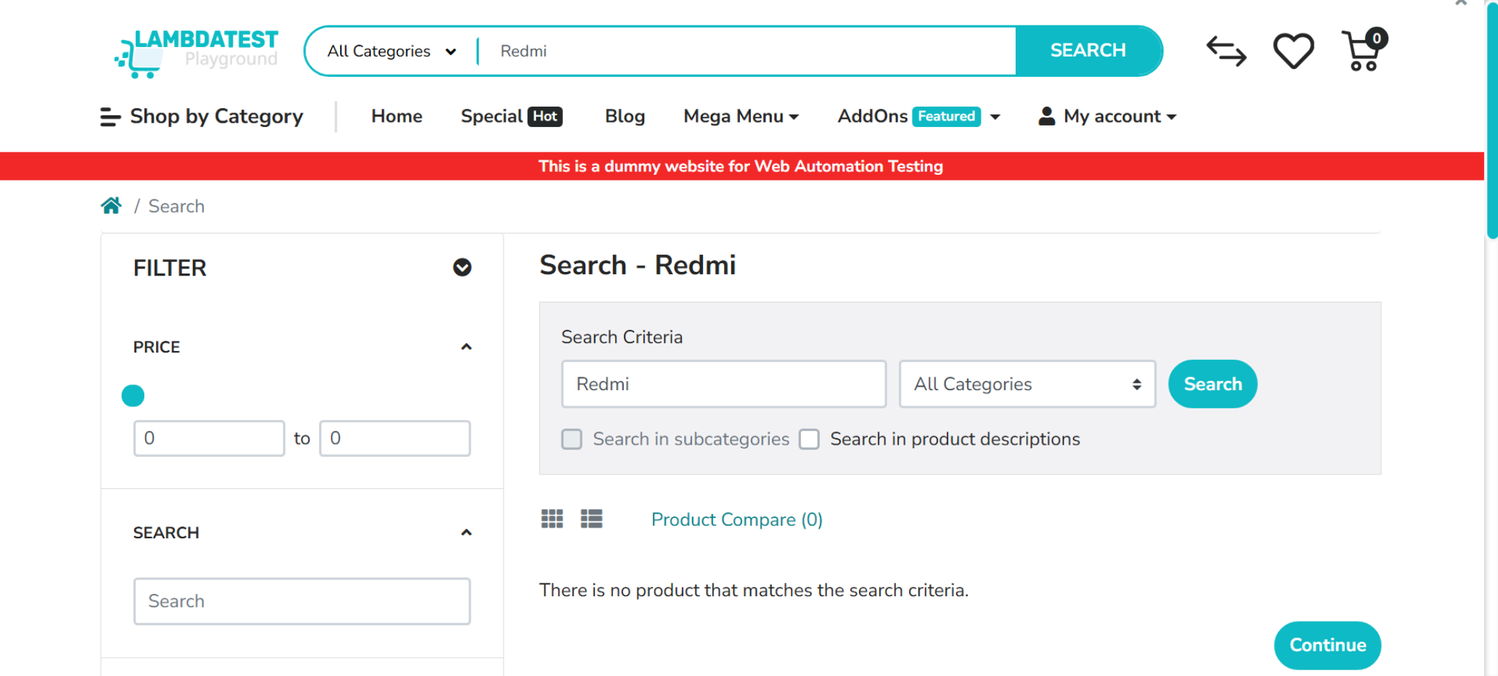
FAILED TEST CASE - WebPage Screenshot

Slide 26
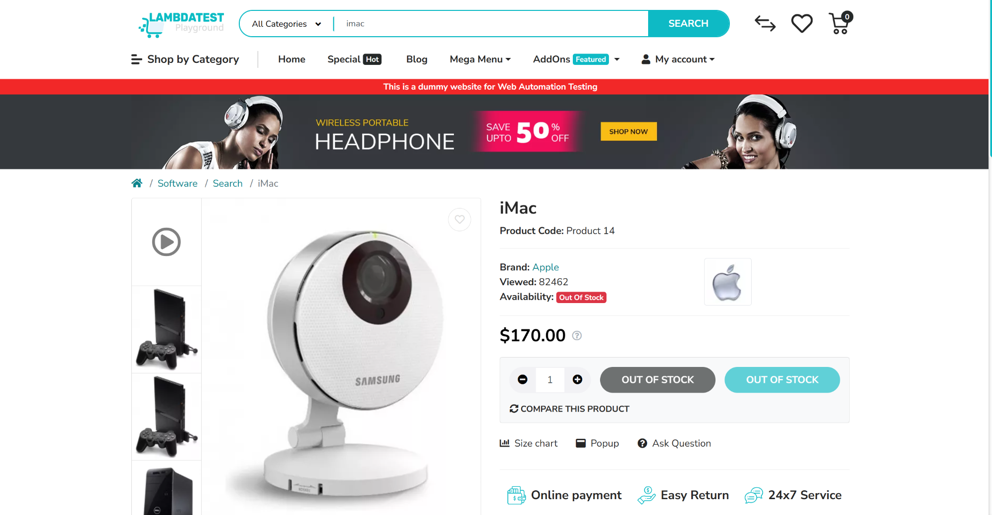
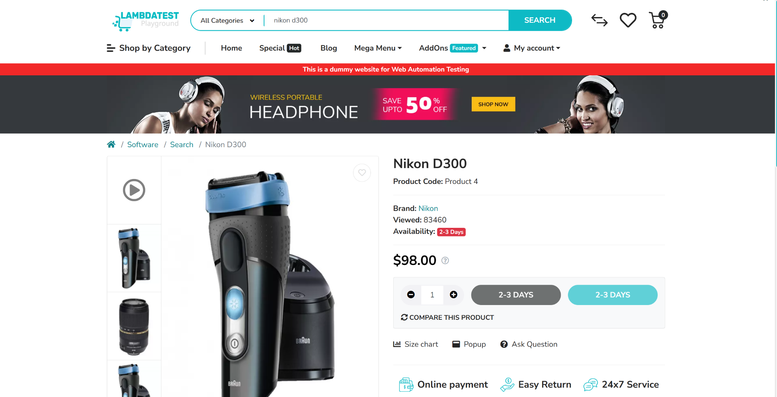
Out of Stock WebPages Screenshot
Pytest report.html
Pytest — Tests Passed (report_HH-MM-SS.html)
Shows: Pass/fail count · 36 parametrized results · test names with CSV row IDs · duration
IIHT | WIPRO FEB 2026 | CAPSTONE PROJECT — Project 2: Pytest + Selenium

Slide 27
Project 2 — Challenges Faced
Pytest + Selenium
Real problems we encountered and how we solved them
01
⏱️
Cart Page Load Delay — StaleElement Error
02
📸
Screenshot Not Embedding in HTML Report
⚠ Problem
⚠ Problem
navigate_to_cart() was clicking the cart link and immediately trying to find items, but the cart popup took several seconds to load, causing StaleElementReferenceException.
The conftest.py screenshot hook captured the PNG file but it was not appearing inside the HTML report — the image tag was missing from the failed test row.
✔ Solution
✔ Solution
Added an explicit 15-second wait using WebDriverWait for the cart container to be visible before interacting. This eliminated the intermittent failure completely.
Fixed by using pytest_html.extras.html() to inject the base64-encoded image directly into the report's extra column. The image now appears inline under the failed test.
03
🔄
Parametrize Scope — Driver Restarting Per Test
04
📧
Dynamic Email + Parametrize Conflict
⚠ Problem
⚠ Problem
With function-scoped driver fixture, a new browser opened for every parametrized row, making the test suite very slow — 36 browser launches per run.
The CSV had a static email value, so parametrized runs would try to register the same email 6 times — only the first run passed, the rest failed with 'email exists'.
✔ Solution
✔ Solution
Changed driver fixture scope to 'class' — one browser session is shared across all test functions in the class, maintaining login state and cutting run time significantly.
Added logic in test_02 to replace the CSV email with a runtime-generated unique email using Python's datetime.now() — each parametrized row gets a completely unique email.
IIHT | WIPRO FEB 2026 | CAPSTONE PROJECT — Project 2: Pytest + Selenium

Slide 28
Conclusion — E-Commerce UI Automation
Project 1 (Robot Framework) + Project 2 (Pytest + Selenium) — Combined Outcome & Learnings
Both projects automate the SAME 5 E-Commerce end-to-end scenarios using two different industry-standard frameworks
Project 1 — Robot Framework
Project 2 — Pytest + Selenium
Keyword-Driven · Data-Driven · SeleniumLibrary
Page Object Model · Fixtures · Parametrize
5 E2E test scenarios automated (TC01–TC05) + 1 full flow suite
6 page object classes: BasePage + LoginPage + 4 feature pages
7 reusable keyword files + locators.robot for centralized locators
conftest.py: driver fixture, step() logger, screenshot hook
DataDriver Library + 4 CSV files — auto multi-row execution
6 test functions × 6 CSV rows = 36 parametrized test executions
Dynamic email generation ensures unique users every run
step() function logs every action directly into HTML report
Auto-generated report.html + log.html after every execution
Failure screenshots auto-embedded as base64 in HTML report
Best practices: POM, explicit waits, screenshot on failure
Cross-browser support: Chrome, Firefox, Edge via config.ini
Combined Outcome
Automated 5 real-world E-Commerce user journeys end-to-end using two different frameworks — proving the same test goals can be achieved with keyword-driven (RF) and code-driven (Pytest+POM) approaches.
Gained hands-on industry experience in framework design, test data management, CI-ready execution, HTML reporting, and failure handling — skills directly applicable to real automation engineering roles.
IIHT | WIPRO FEB 2026 | CAPSTONE PROJECT

Slide 29
PROJECT 03
Foodie App — API Testing
Flask REST API + Pytest + Robot Framework + Postman

Slide 30



Project 3 — Project Objective
Understanding the purpose, scope, and goals of the Foodie App REST API testing project
What is this project?
Quick Facts
Application
This project involves building and testing a complete REST API for a food delivery application called Foodie App. The backend is a Python Flask application with in-memory storage exposing 18 endpoints across 5 business modules. The APIs are tested three ways — manually via Postman, automated with Pytest using the requests library, and automated with Robot Framework using the RequestsLibrary.
Foodie App — Food Delivery REST API
Backend Framework
Python Flask (in-memory storage)
Total Endpoints
Primary Goal
Design, build, and test 18 REST API endpoints covering all 5 modules of the Foodie food delivery app
18 REST APIs across 5 modules
HTTP Methods
GET, POST, PUT, DELETE
API Design
RESTful endpoints using GET, POST, PUT, DELETE — proper HTTP status codes 200, 201, 400, 404
Manual Testing
Postman — 5 module collections
Backend
Python Flask with in-memory dicts — no database needed, runs locally at http://127.0.0.1:5000
Pytest Automation
test_foodie.py — 18 test functions
Testing Approach
Three-layered: Postman (manual), Pytest requests (automated), Robot Framework RequestsLibrary (automated)
RF Automation
foodie.robot — 18 test cases
Deliverables
app.py Flask server + test_foodie.py + foodie.robot + Postman collection with 5 module groups
Run Server
python app.py → 127.0.0.1:5000
IIHT | WIPRO FEB 2026 | CAPSTONE PROJECT — Project 3: Foodie App API

Slide 31




Project 3 — Foodie App Overview & 18 API Endpoints
Python Flask backend with in-memory storage · 18 REST endpoints across 5 modules
18
5
3
5
REST API
Endpoints
Feature
Modules
Test
Approaches
HTTP
Methods
APIs 1–4 — Restaurant Module
APIs 5–8 — Dish Module
APIs 9–12 — Admin Module
POST /api/v1/restaurants → 201
POST /api/v1/restaurants/{id}/dishes → 201
PUT /api/v1/admin/restaurants/{id}/approve → 200
PUT /api/v1/restaurants/{id} → 200
PUT /api/v1/dishes/{id} → 200
PUT /api/v1/admin/restaurants/{id}/disable → 200
PUT /api/v1/restaurants/{id}/disable → 200
PUT /api/v1/dishes/{id}/status → 200
GET /api/v1/admin/feedback → 200
GET /api/v1/restaurants/{id} → 200
DELETE /api/v1/dishes/{id} → 200
GET /api/v1/admin/orders → 200
APIs 13–16 — User / Customer Module
APIs 17–18 — Order Module
POST /api/v1/users/register → 201
GET /api/v1/restaurants/{id}/orders → 200
GET /api/v1/restaurants/search?name= → 200
GET /api/v1/users/{id}/orders → 200
POST /api/v1/orders → 201
POST /api/v1/ratings → 201
IIHT | WIPRO FEB 2026 | CAPSTONE PROJECT — Project 3: Foodie App API

Slide 32
Project 3 — Flask Backend & Automated Test Details
app.py structure · test_foodie.py (18 functions) · foodie.robot (18 test cases)
app.py — Flask
test_foodie.py (Pytest)
foodie.robot (Robot FW)
In-Memory Storage
test_1_register_restaurant
201
1 Register Restaurant
restaurants{}, dishes{}, users{}, orders{}, ratings{} — Python dicts. No database needed.
test_2_update_restaurant
200
2 Update Restaurant
test_3_disable_restaurant
200
3 Disable Restaurant
test_4_view_restaurant_profile
200
4 View Restaurant Profile
ID Counters
test_5_add_dish
201
5 Add Dish
Global int counters auto-increment each new resource ID for all 5 modules.
test_6_update_dish
200
6 Update Dish
test_7_enable_disable_dish
200
7 Enable Disable Dish
18 Route Handlers
test_8_delete_dish
200
8 Delete Dish
@app.route decorators. Each validates input, updates dict, returns jsonify response.
test_9_approve_restaurant
200
9 Approve Restaurant
test_10_admin_disable
200
10 Admin Disable Restaurant
test_11_view_feedback
200
11 View Feedback
Error Handling
test_12_view_orders_status
200
12 View Order Status
400 missing fields, 404 not found, 201 created, 200 updated. Consistent across all routes.
test_13_user_registration
201
13 User Registration
test_14_search_restaurants
200
14 Search Restaurants
Run Server
test_15_place_order
201
15 Place Order
test_16_give_rating
201
16 Give Rating
python app.py → starts at http://127.0.0.1:5000 in debug mode.
test_17_orders_by_restaurant
200
17 View Orders By Restaurant
test_18_orders_by_user
200
18 View Orders By User
IIHT | WIPRO FEB 2026 | CAPSTONE PROJECT — Project 3: Foodie App API

Slide 33
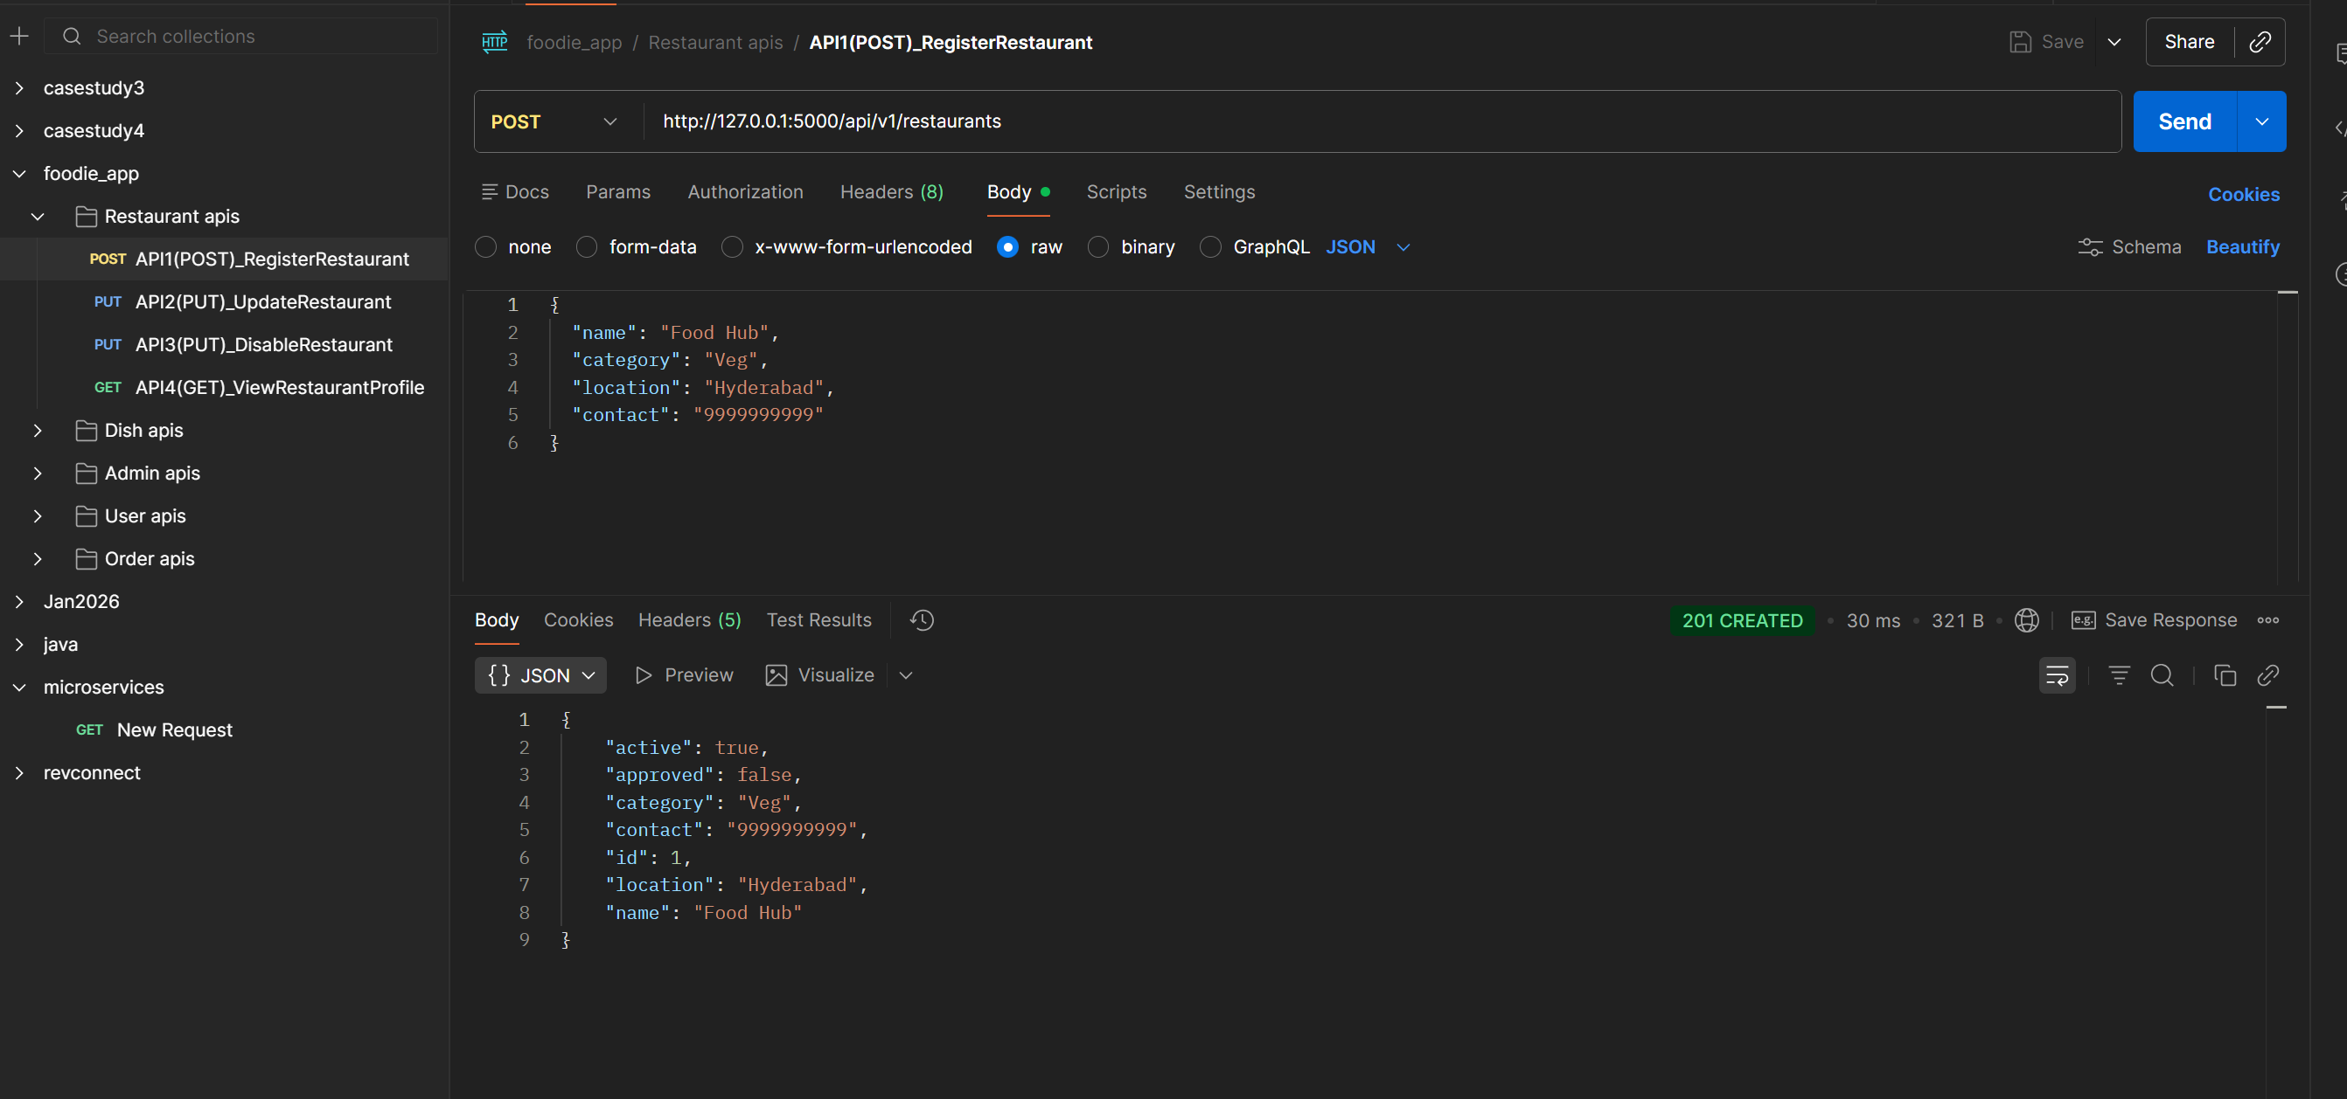
Project 3 — Postman | Restaurant Module — API 1
POST /api/v1/restaurants → 201 |
POST
/api/v1/restaurants
Expected Status:
201
Restaurant Module · APIs 1–4
API 1
screenshot placeholder
Description
Register new restaurant with name, category, location, contact
📷
What to verify in Postman:
Status code returns 201
[ Replace with actual screenshot ]
Response body contains expected JSON fields
Request body / params are correctly structured
Error cases: send missing fields → expect 400
Postman — API 1: POST /api/v1/restaurants
Shows: request body · response JSON · status 201 · response time
IIHT | WIPRO FEB 2026 | CAPSTONE PROJECT — Project 3: Foodie App API

Slide 34
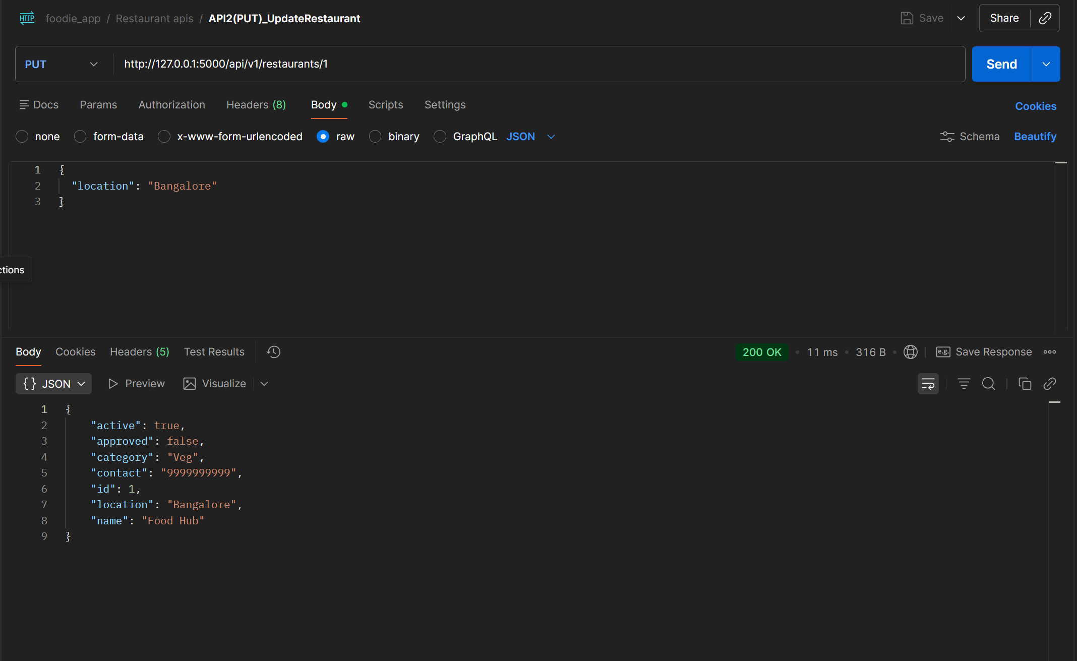
Project 3 — Postman | Restaurant Module — API 2
PUT /api/v1/restaurants/{id} → 200 |
PUT
/api/v1/restaurants/{id}
Restaurant Module · APIs 1–4
API 2
screenshot placeholder
Expected Status:
200
Description
Update restaurant name or location fields
📷
What to verify in Postman:
Status code returns 200
[ Replace with actual screenshot ]
Response body contains expected JSON fields
Request body / params are correctly structured
Error cases: send missing fields → expect 400
Postman — API 2: PUT /api/v1/restaurants/{id}
Shows: request body · response JSON · status 200 · response time
IIHT | WIPRO FEB 2026 | CAPSTONE PROJECT — Project 3: Foodie App API

Slide 35
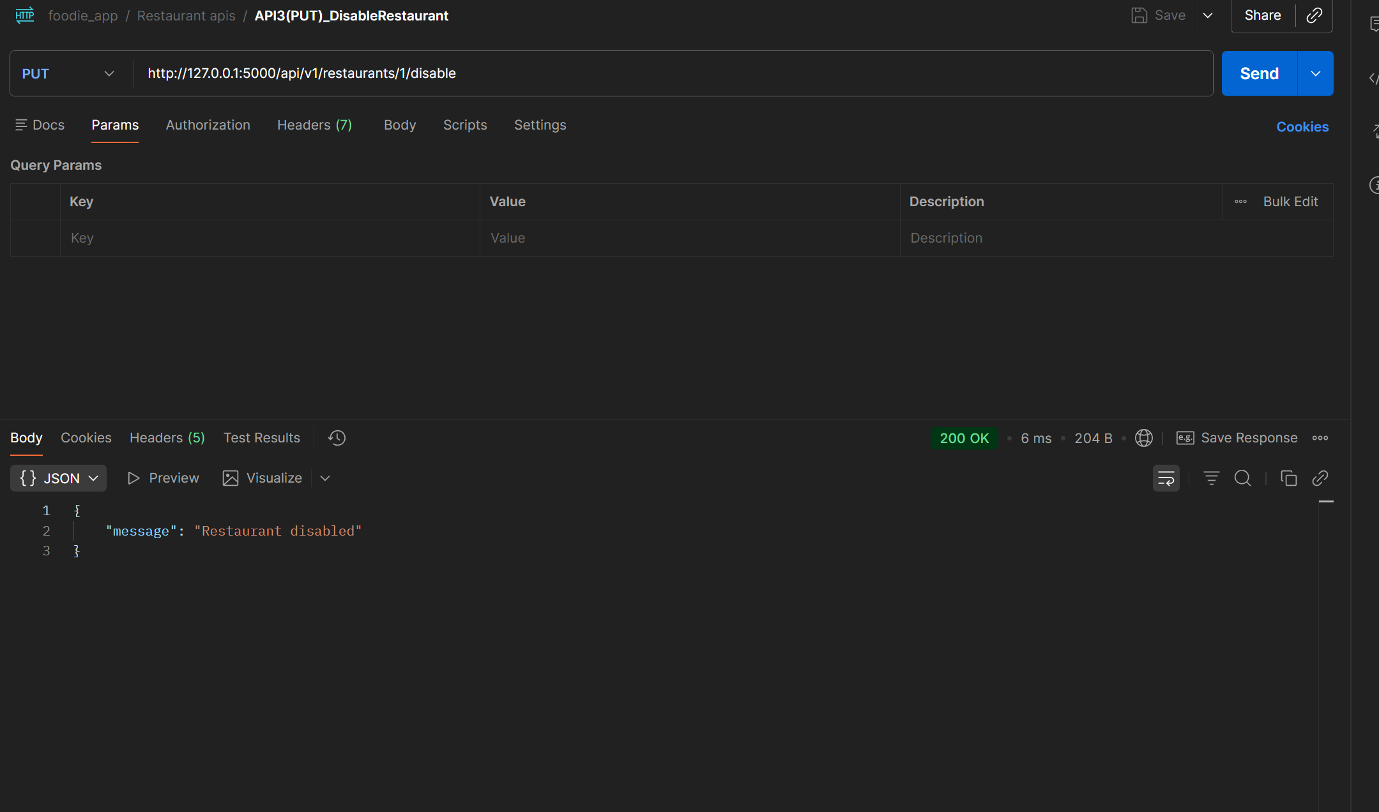
Project 3 — Postman | Restaurant Module — API 3
PUT /api/v1/restaurants/{id}/disable → 200 |
📌 In Postman: send this request → screenshot the response panel → paste below | Badge colour: POST=Navy PUT=Gold GET=Green DELETE=Red
Restaurant Module · APIs 1–4
API 3
screenshot placeholder
PUT
/api/v1/restaurants/{id}/disable
Expected Status:
200
Description
Disable restaurant — sets active=False
📷
What to verify in Postman:
Status code returns 200
[ Replace with actual screenshot ]
Response body contains expected JSON fields
Request body / params are correctly structured
Error cases: send missing fields → expect 400
Postman — API 3: PUT /api/v1/restaurants/{id}/disable
Shows: request body · response JSON · status 200 · response time
IIHT | WIPRO FEB 2026 | CAPSTONE PROJECT — Project 3: Foodie App API

Slide 36
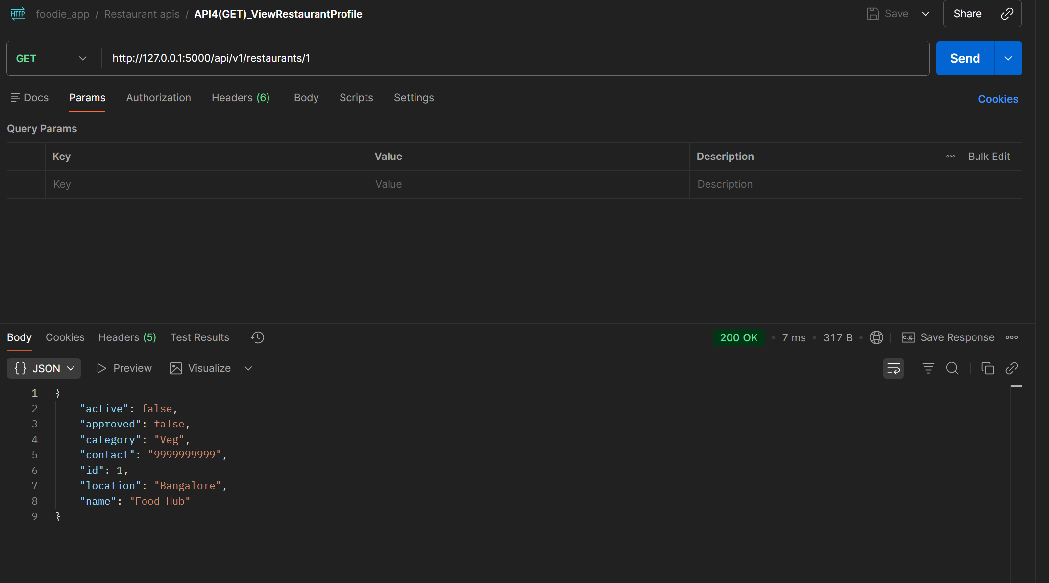
Project 3 — Postman | Restaurant Module — API 4
GET /api/v1/restaurants/{id} → 200 |
📌 In Postman: send this request → screenshot the response panel → paste below | Badge colour: POST=Navy PUT=Gold GET=Green DELETE=Red
Restaurant Module · APIs 1–4
API 4
screenshot placeholder
GET
/api/v1/restaurants/{id}
Expected Status:
200
Description
View full restaurant profile by ID
📷
What to verify in Postman:
Status code returns 200
[ Replace with actual screenshot ]
Response body contains expected JSON fields
Request body / params are correctly structured
Error cases: send missing fields → expect 400
Postman — API 4: GET /api/v1/restaurants/{id}
Shows: request body · response JSON · status 200 · response time
IIHT | WIPRO FEB 2026 | CAPSTONE PROJECT — Project 3: Foodie App API

Slide 37
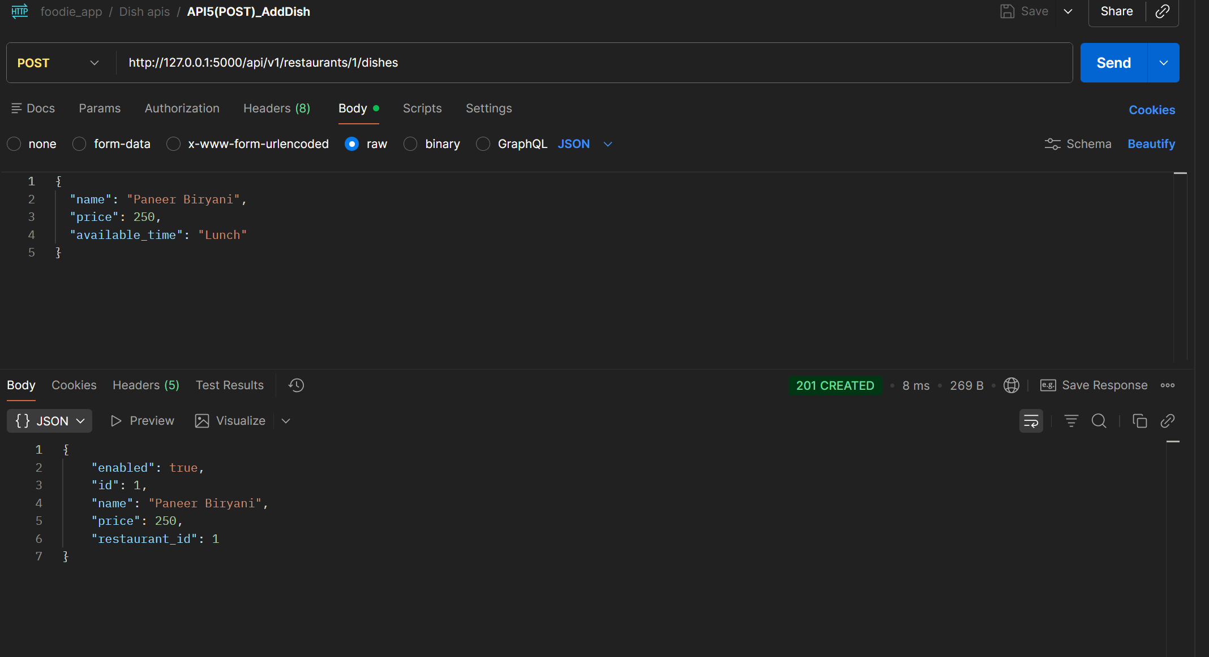
Project 3 — Postman | Dish Module — API 5
POST /api/v1/restaurants/{id}/dishes → 201 |
📌 In Postman: send this request → screenshot the response panel → paste below | Badge colour: POST=Navy PUT=Gold GET=Green DELETE=Red
Dish Module · APIs 5–8
API 5
screenshot placeholder
POST
/api/v1/restaurants/{id}/dishes
Expected Status:
201
Description
Add dish to restaurant with name, price, available_time
📷
What to verify in Postman:
Status code returns 201
[ Replace with actual screenshot ]
Response body contains expected JSON fields
Request body / params are correctly structured
Error cases: send missing fields → expect 400
Postman — API 5: POST /api/v1/restaurants/{id}/dishes
Shows: request body · response JSON · status 201 · response time
IIHT | WIPRO FEB 2026 | CAPSTONE PROJECT — Project 3: Foodie App API

Slide 38
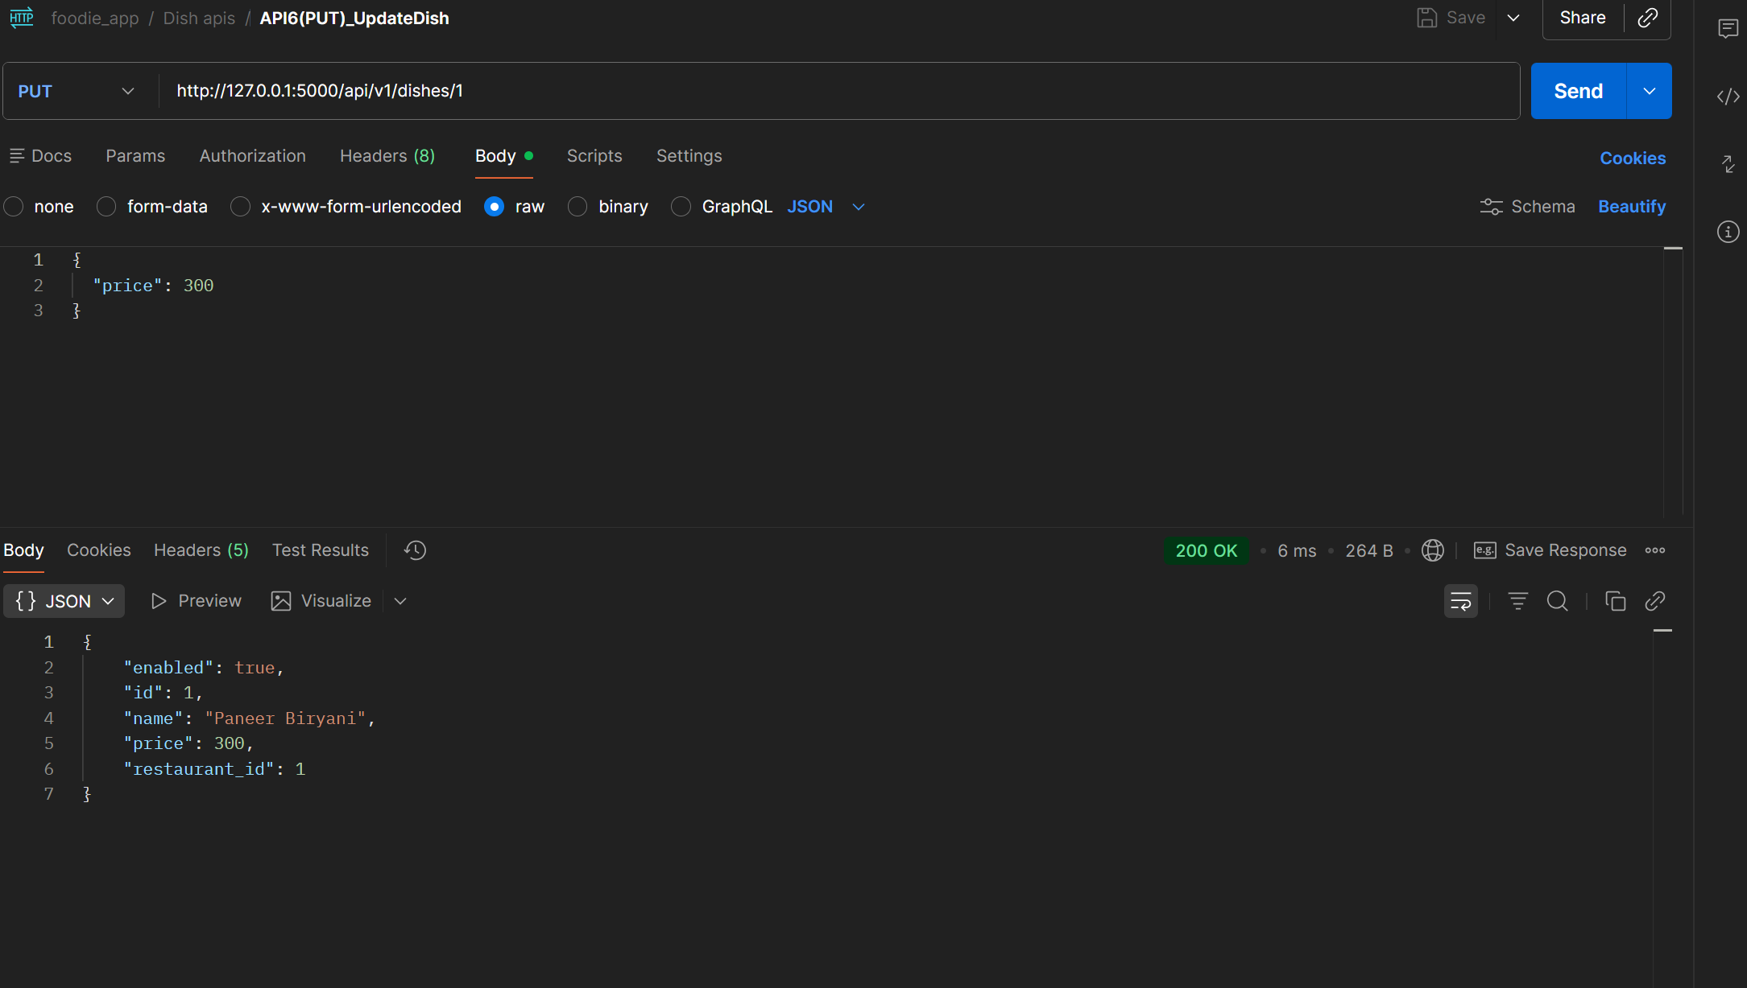
Project 3 — Postman | Dish Module — API 6
PUT /api/v1/dishes/{id} → 200 |
📌 In Postman: send this request → screenshot the response panel → paste below | Badge colour: POST=Navy PUT=Gold GET=Green DELETE=Red
Dish Module · APIs 5–8
API 6
screenshot placeholder
PUT
/api/v1/dishes/{id}
Expected Status:
200
Description
Update dish name or price
📷
What to verify in Postman:
Status code returns 200
[ Replace with actual screenshot ]
Response body contains expected JSON fields
Request body / params are correctly structured
Error cases: send missing fields → expect 400
Postman — API 6: PUT /api/v1/dishes/{id}
Shows: request body · response JSON · status 200 · response time
IIHT | WIPRO FEB 2026 | CAPSTONE PROJECT — Project 3: Foodie App API

Slide 39
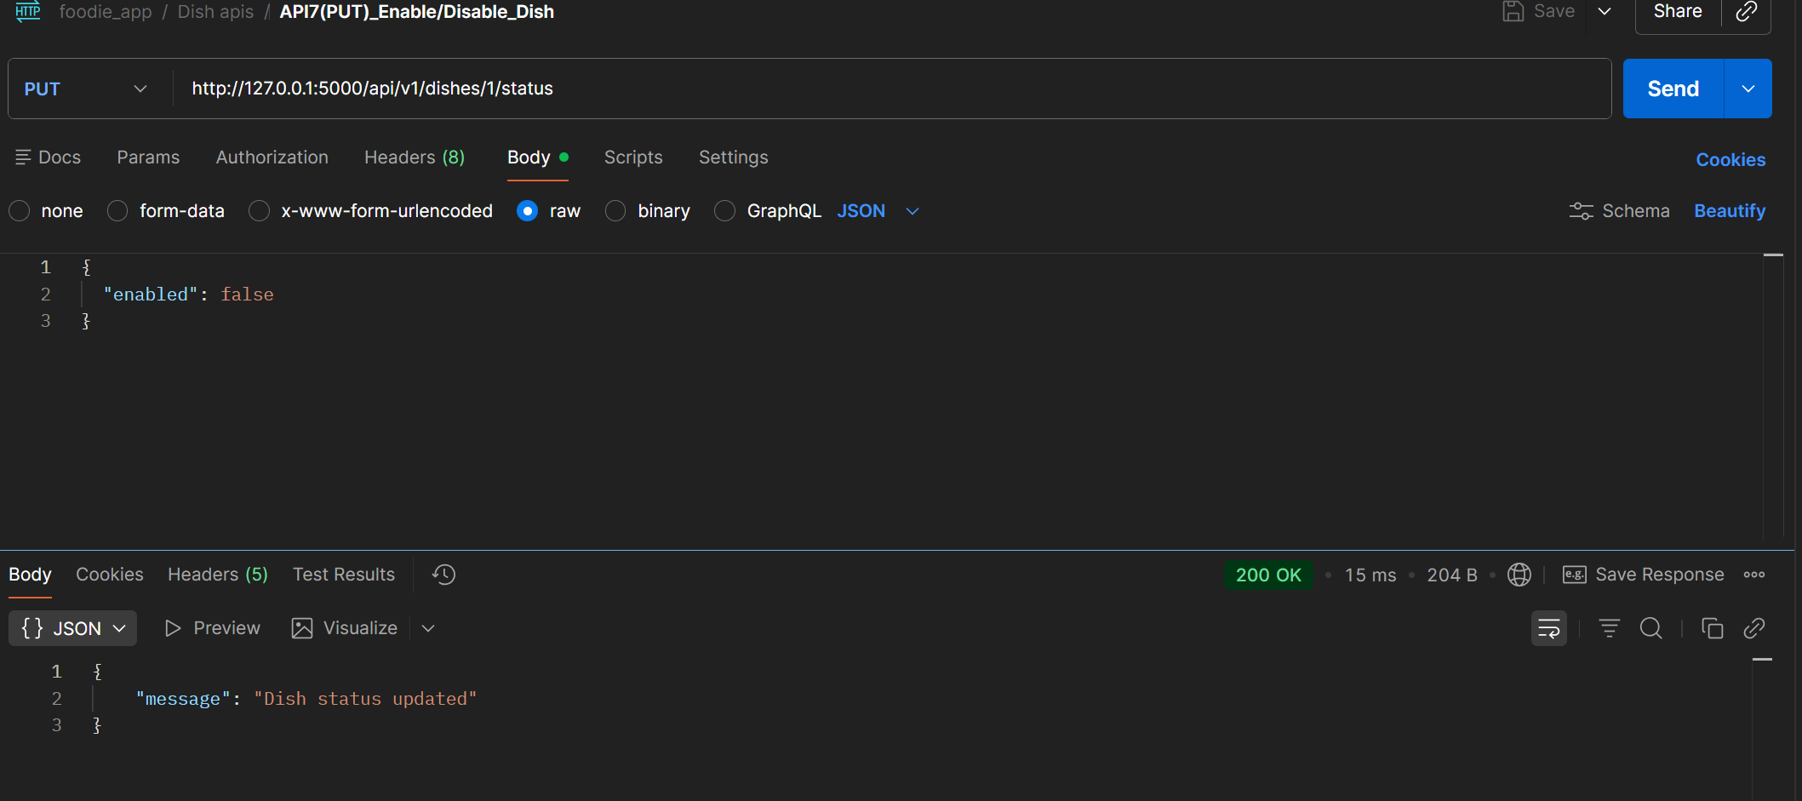
Project 3 — Postman | Dish Module — API 7
PUT /api/v1/dishes/{id}/status → 200
📌 In Postman: send this request → screenshot the response panel → paste below | Badge colour: POST=Navy PUT=Gold GET=Green DELETE=Red
Dish Module · APIs 5–8
API 7
screenshot placeholder
PUT
/api/v1/dishes/{id}/status
Expected Status:
200
Description
Enable or disable dish with {enabled: true/false}
📷
What to verify in Postman:
Status code returns 200
[ Replace with actual screenshot ]
Response body contains expected JSON fields
Request body / params are correctly structured
Error cases: send missing fields → expect 400
Postman — API 7: PUT /api/v1/dishes/{id}/status
Shows: request body · response JSON · status 200 · response time
IIHT | WIPRO FEB 2026 | CAPSTONE PROJECT — Project 3: Foodie App API

Slide 40
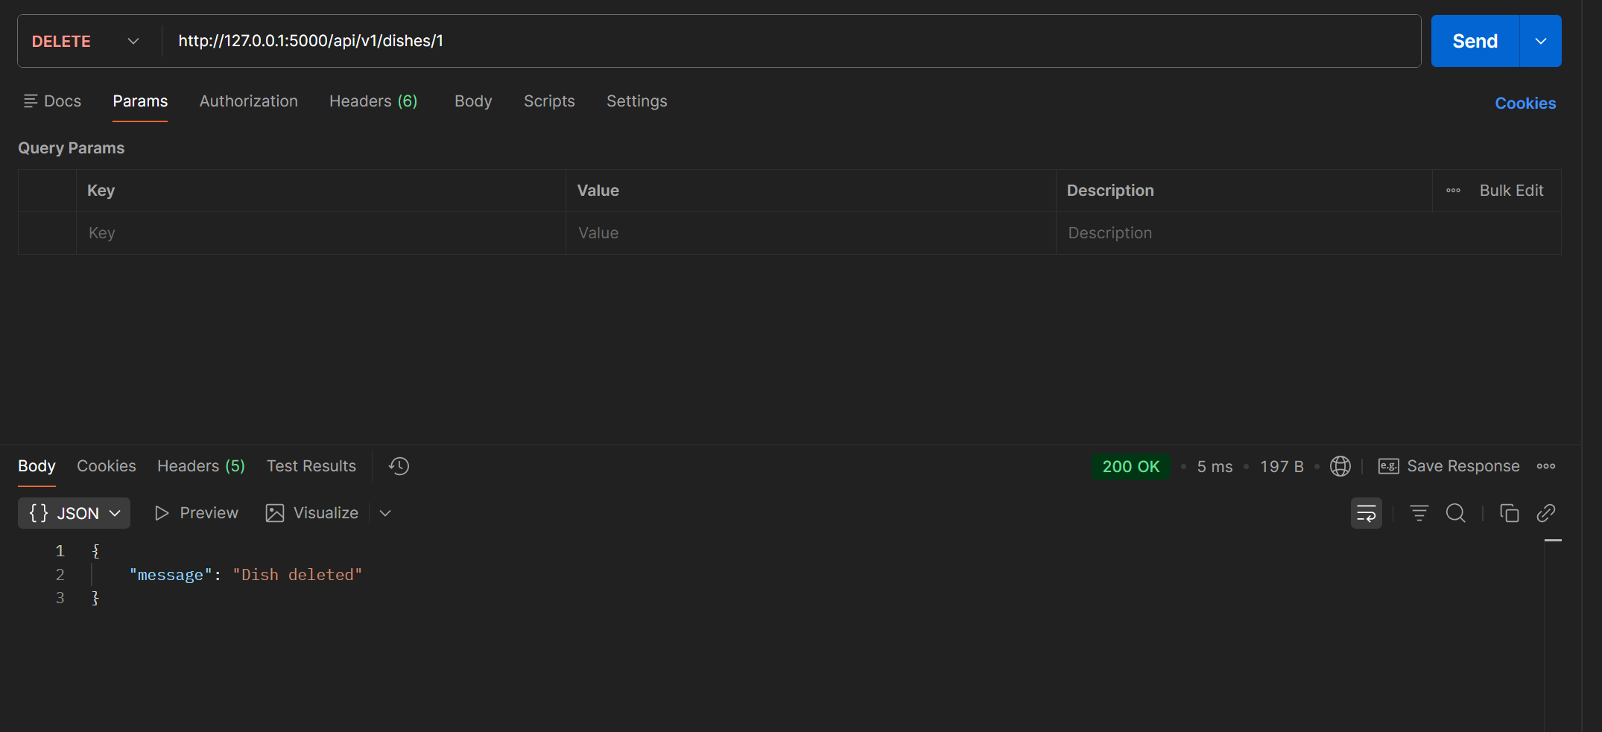
Project 3 — Postman | Dish Module — API 8
DELETE /api/v1/dishes/{id} → 200 |
📌 In Postman: send this request → screenshot the response panel → paste below | Badge colour: POST=Navy PUT=Gold GET=Green DELETE=Red
Dish Module · APIs 5–8
API 8
screenshot placeholder
DELETE
/api/v1/dishes/{id}
Expected Status:
200
Description
Permanently remove dish from the system
📷
What to verify in Postman:
Status code returns 200
[ Replace with actual screenshot ]
Response body contains expected JSON fields
Request body / params are correctly structured
Error cases: send missing fields → expect 400
Postman — API 8: DELETE /api/v1/dishes/{id}
Shows: request body · response JSON · status 200 · response time
IIHT | WIPRO FEB 2026 | CAPSTONE PROJECT — Project 3: Foodie App API

Slide 41
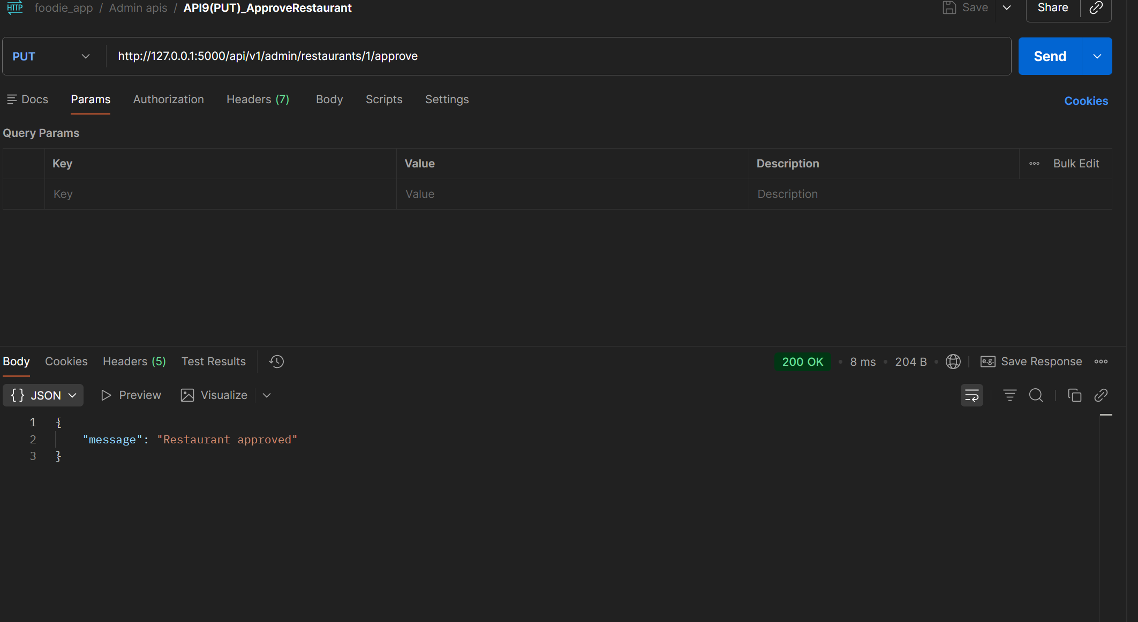
Project 3 — Postman | Admin Module — API 9
PUT /api/v1/admin/restaurants/{id}/approve → 200 |
📌 In Postman: send this request → screenshot the response panel → paste below | Badge colour: POST=Navy PUT=Gold GET=Green DELETE=Red
Admin Module · APIs 9–12
API 9
screenshot placeholder
PUT
/api/v1/admin/restaurants/{id}/approve
Expected Status:
200
Description
Admin approves restaurant — sets approved=True
📷
What to verify in Postman:
Status code returns 200
[ Replace with actual screenshot ]
Response body contains expected JSON fields
Request body / params are correctly structured
Error cases: send missing fields → expect 400
Postman — API 9: PUT /api/v1/admin/restaurants/{id}/approve
Shows: request body · response JSON · status 200 · response time
IIHT | WIPRO FEB 2026 | CAPSTONE PROJECT — Project 3: Foodie App API

Slide 42
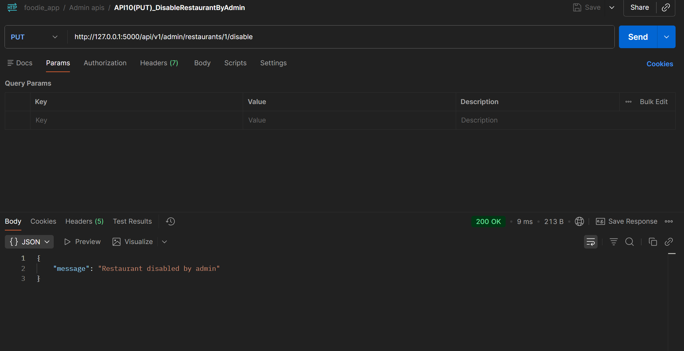
Project 3 — Postman | Admin Module — API 10
PUT /api/v1/admin/restaurants/{id}/disable → 200 |
📌 In Postman: send this request → screenshot the response panel → paste below | Badge colour: POST=Navy PUT=Gold GET=Green DELETE=Red
Admin Module · APIs 9–12
API 10
screenshot placeholder
PUT
/api/v1/admin/restaurants/{id}/disable
Expected Status:
200
Description
Admin force-disables any restaurant
📷
What to verify in Postman:
Status code returns 200
[ Replace with actual screenshot ]
Response body contains expected JSON fields
Request body / params are correctly structured
Error cases: send missing fields → expect 400
Postman — API 10: PUT /api/v1/admin/restaurants/{id}/disable
Shows: request body · response JSON · status 200 · response time
IIHT | WIPRO FEB 2026 | CAPSTONE PROJECT — Project 3: Foodie App API

Slide 43
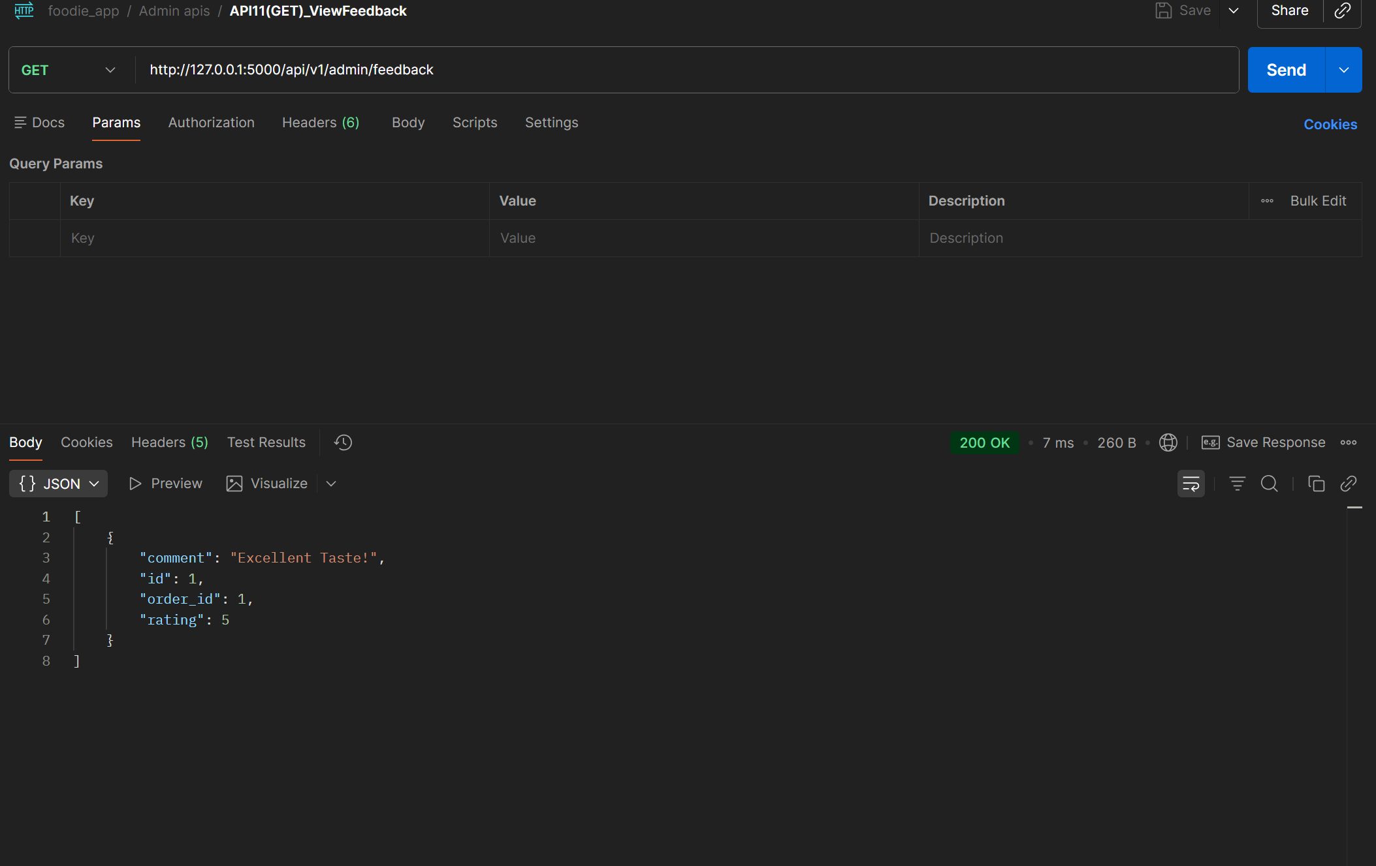
Project 3 — Postman | Admin Module — API 11
GET /api/v1/admin/feedback → 200 |
📌 In Postman: send this request → screenshot the response panel → paste below | Badge colour: POST=Navy PUT=Gold GET=Green DELETE=Red
Admin Module · APIs 9–12
API 11
screenshot placeholder
GET
/api/v1/admin/feedback
Expected Status:
200
Description
View all customer ratings and comments
📷
What to verify in Postman:
Status code returns 200
[ Replace with actual screenshot ]
Response body contains expected JSON fields
Request body / params are correctly structured
Error cases: send missing fields → expect 400
Postman — API 11: GET /api/v1/admin/feedback
Shows: request body · response JSON · status 200 · response time
IIHT | WIPRO FEB 2026 | CAPSTONE PROJECT — Project 3: Foodie App API

Slide 44
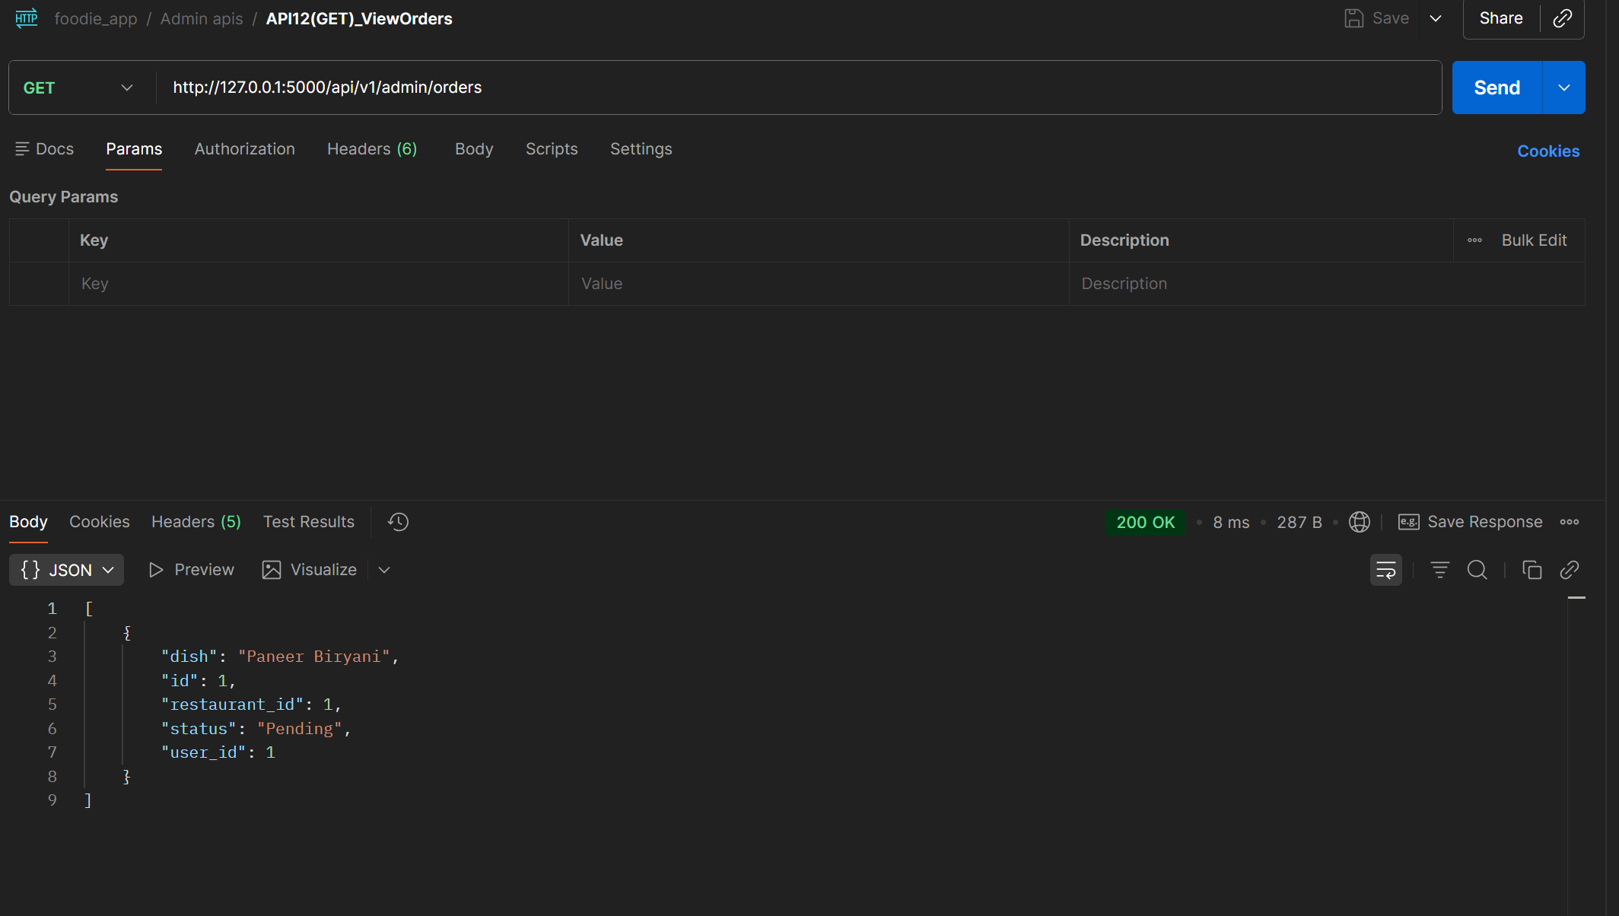
Project 3 — Postman | Admin Module — API 12
GET /api/v1/admin/orders → 200 |
📌 In Postman: send this request → screenshot the response panel → paste below | Badge colour: POST=Navy PUT=Gold GET=Green DELETE=Red
Admin Module · APIs 9–12
API 12
screenshot placeholder
GET
/api/v1/admin/orders
Expected Status:
200
Description
View all orders in the system
📷
What to verify in Postman:
Status code returns 200
[ Replace with actual screenshot ]
Response body contains expected JSON fields
Request body / params are correctly structured
Error cases: send missing fields → expect 400
Postman — API 12: GET /api/v1/admin/orders
Shows: request body · response JSON · status 200 · response time
IIHT | WIPRO FEB 2026 | CAPSTONE PROJECT — Project 3: Foodie App API

Slide 45
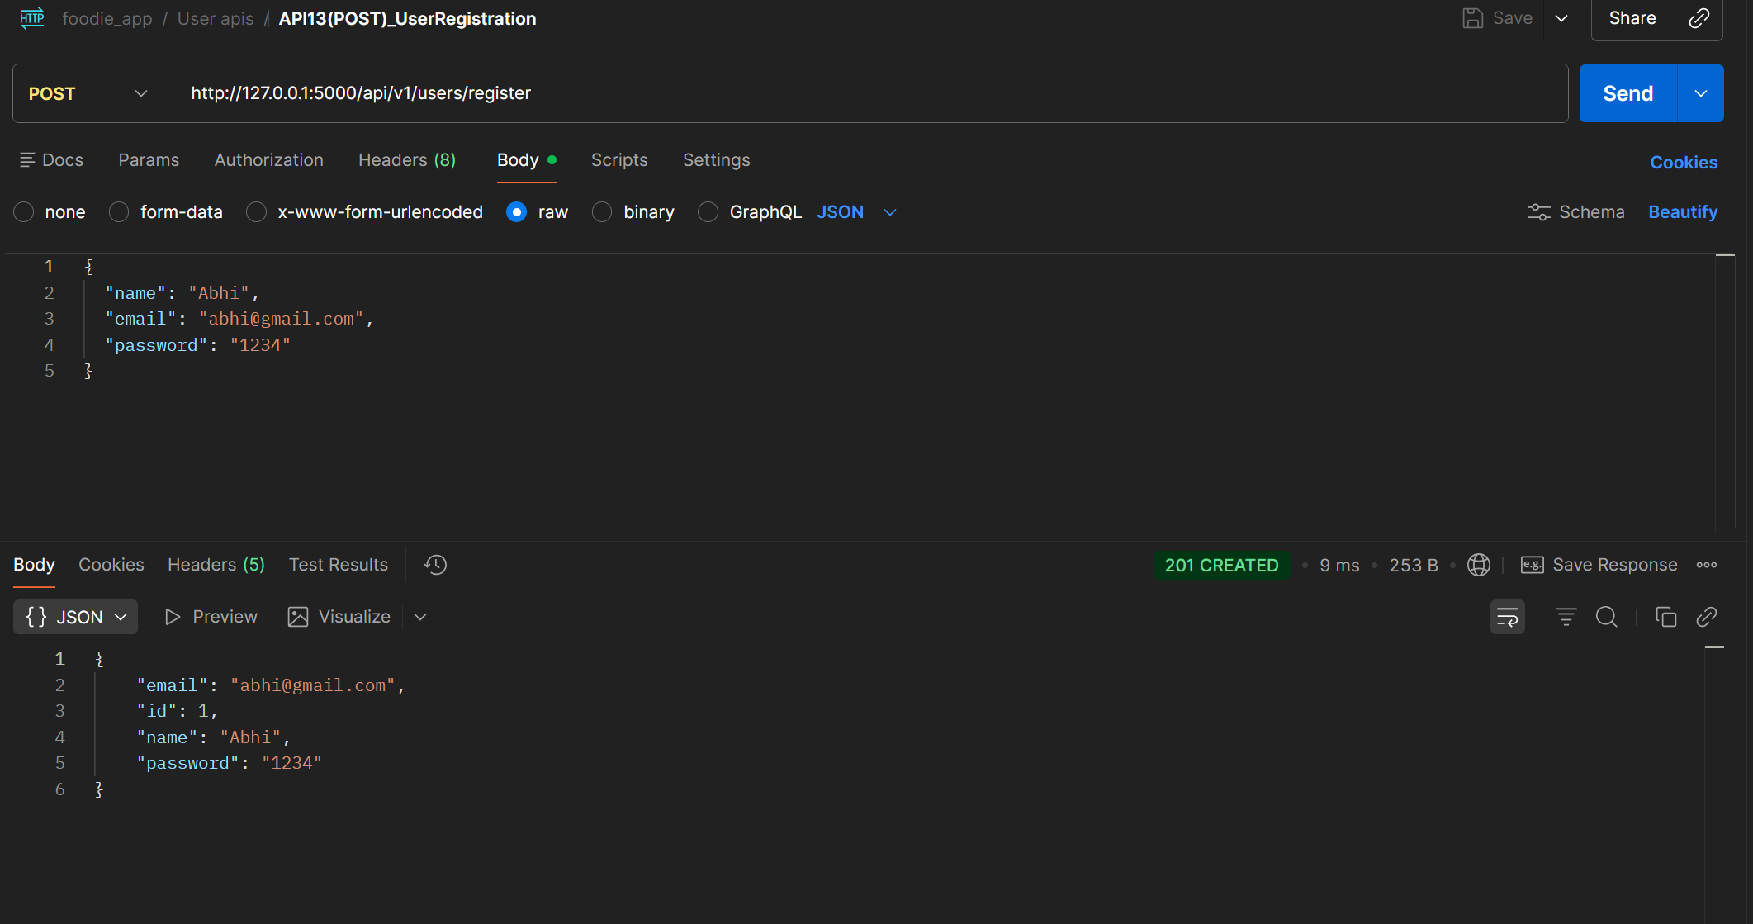
Project 3 — Postman | User / Customer Module — API 13
POST /api/v1/users/register → 201
📌 In Postman: send this request → screenshot the response panel → paste below | Badge colour: POST=Navy PUT=Gold GET=Green DELETE=Red
User / Customer Module · APIs 13–16
API 13
screenshot placeholder
POST
/api/v1/users/register
Expected Status:
201
Description
Register new customer with name, email, password
📷
What to verify in Postman:
Status code returns 201
[ Replace with actual screenshot ]
Response body contains expected JSON fields
Request body / params are correctly structured
Error cases: send missing fields → expect 400
Postman — API 13: POST /api/v1/users/register
Shows: request body · response JSON · status 201 · response time
IIHT | WIPRO FEB 2026 | CAPSTONE PROJECT — Project 3: Foodie App API

Slide 46
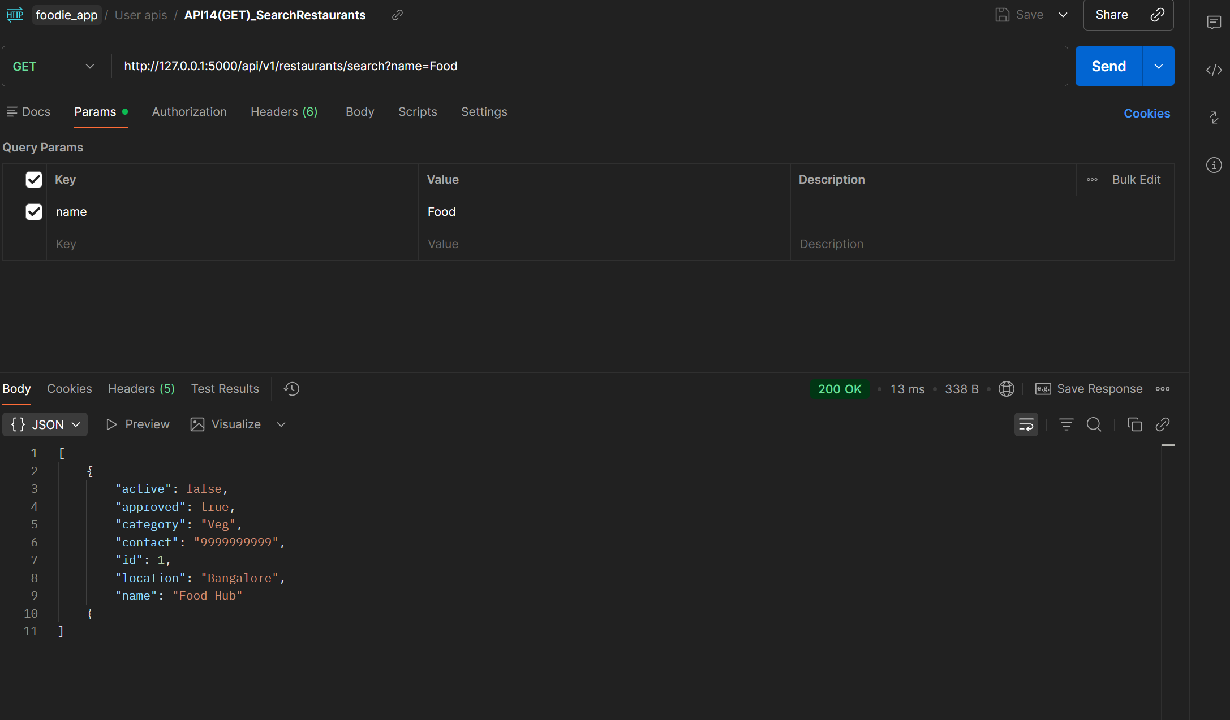
Project 3 — Postman | User / Customer Module — API 14
GET /api/v1/restaurants/search?name=Food → 200 |
📌 In Postman: send this request → screenshot the response panel → paste below | Badge colour: POST=Navy PUT=Gold GET=Green DELETE=Red
User / Customer Module · APIs 13–16
API 14
screenshot placeholder
GET
/api/v1/restaurants/search?name=Food
Expected Status:
200
Description
Search restaurants by name query parameter
📷
What to verify in Postman:
Status code returns 200
[ Replace with actual screenshot ]
Response body contains expected JSON fields
Request body / params are correctly structured
Error cases: send missing fields → expect 400
Postman — API 14: GET /api/v1/restaurants/search?name=Food
Shows: request body · response JSON · status 200 · response time
IIHT | WIPRO FEB 2026 | CAPSTONE PROJECT — Project 3: Foodie App API

Slide 47
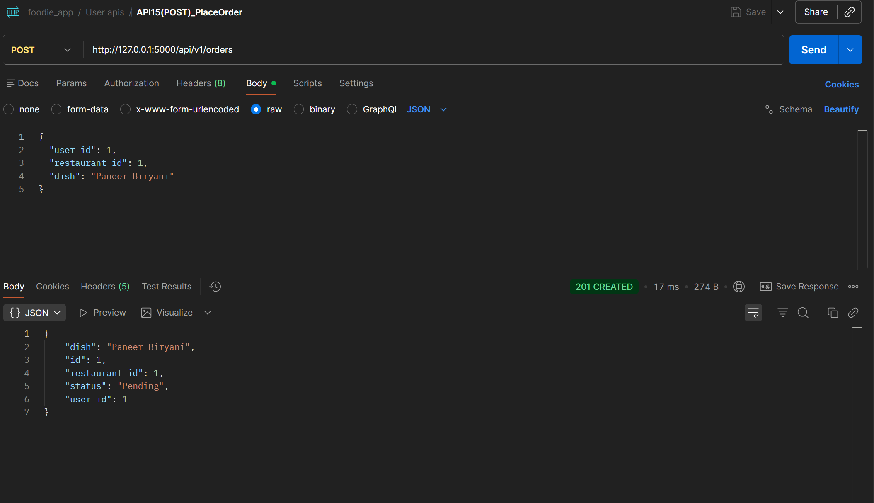
Project 3 — Postman | User / Customer Module — API 15
POST /api/v1/orders → 201 |
📌 In Postman: send this request → screenshot the response panel → paste below | Badge colour: POST=Navy PUT=Gold GET=Green DELETE=Red
User / Customer Module · APIs 13–16
API 15
screenshot placeholder
POST
/api/v1/orders
Expected Status:
201
Description
Place order with user_id, restaurant_id, dish name
📷
What to verify in Postman:
Status code returns 201
[ Replace with actual screenshot ]
Response body contains expected JSON fields
Request body / params are correctly structured
Error cases: send missing fields → expect 400
Postman — API 15: POST /api/v1/orders
Shows: request body · response JSON · status 201 · response time
IIHT | WIPRO FEB 2026 | CAPSTONE PROJECT — Project 3: Foodie App API

Slide 48
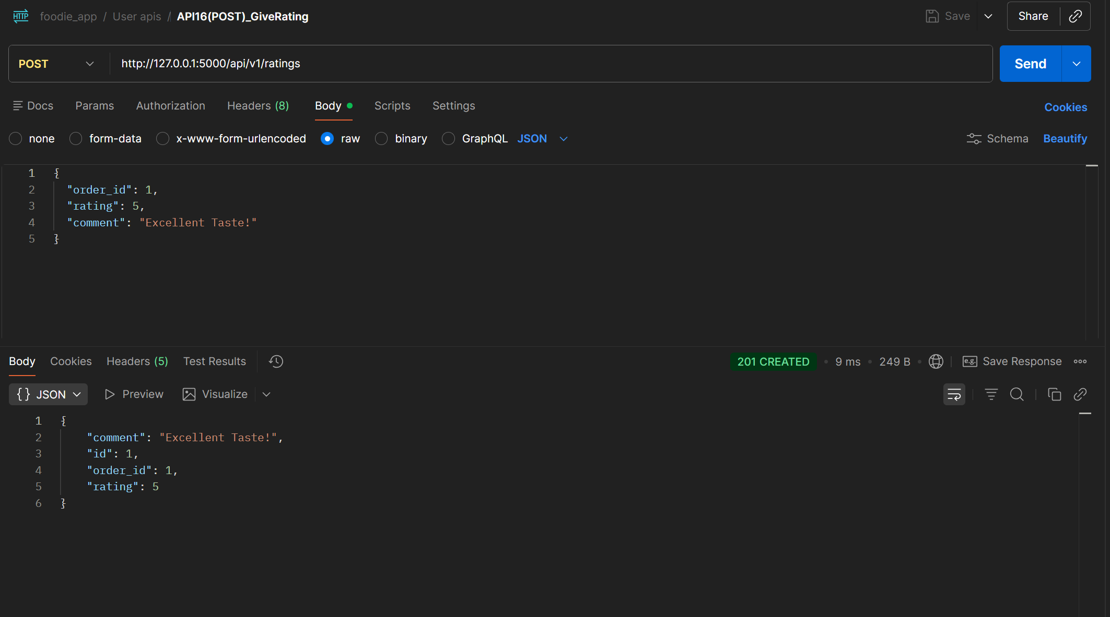
Project 3 — Postman | User / Customer Module — API 16
POST /api/v1/ratings → 200 |
📌 In Postman: send this request → screenshot the response panel → paste below | Badge colour: POST=Navy PUT=Gold GET=Green DELETE=Red
User / Customer Module · APIs 13–16
API 16
screenshot placeholder
POST
/api/v1/ratings
Expected Status:
201
Description
Submit rating with order_id, rating value, comment
📷
What to verify in Postman:
Status code returns 201
[ Replace with actual screenshot ]
Response body contains expected JSON fields
Request body / params are correctly structured
Error cases: send missing fields → expect 400
Postman — API 16: POST /api/v1/ratings
Shows: request body · response JSON · status 201 · response time
IIHT | WIPRO FEB 2026 | CAPSTONE PROJECT — Project 3: Foodie App API

Slide 49
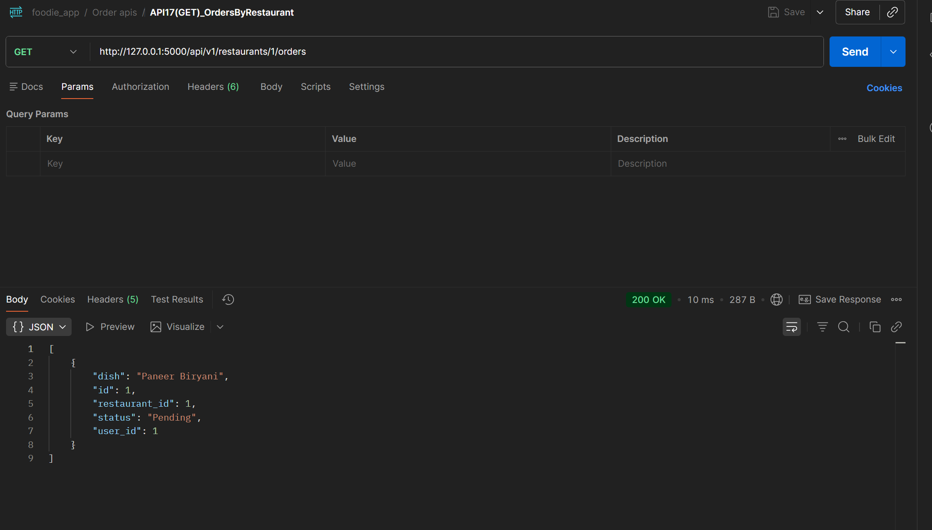
Project 3 — Postman | Order Module — API 17
GET /api/v1/restaurants/{id}/orders → 200 |
📌 In Postman: send this request → screenshot the response panel → paste below | Badge colour: POST=Navy PUT=Gold GET=Green DELETE=Red
Order Module · APIs 17–18
API 17
screenshot placeholder
GET
/api/v1/restaurants/{id}/orders
Expected Status:
200
Description
List all orders placed at a specific restaurant
📷
What to verify in Postman:
Status code returns 200
[ Replace with actual screenshot ]
Response body contains expected JSON fields
Request body / params are correctly structured
Error cases: send missing fields → expect 400
Postman — API 17: GET /api/v1/restaurants/{id}/orders
Shows: request body · response JSON · status 200 · response time
IIHT | WIPRO FEB 2026 | CAPSTONE PROJECT — Project 3: Foodie App API

Slide 50
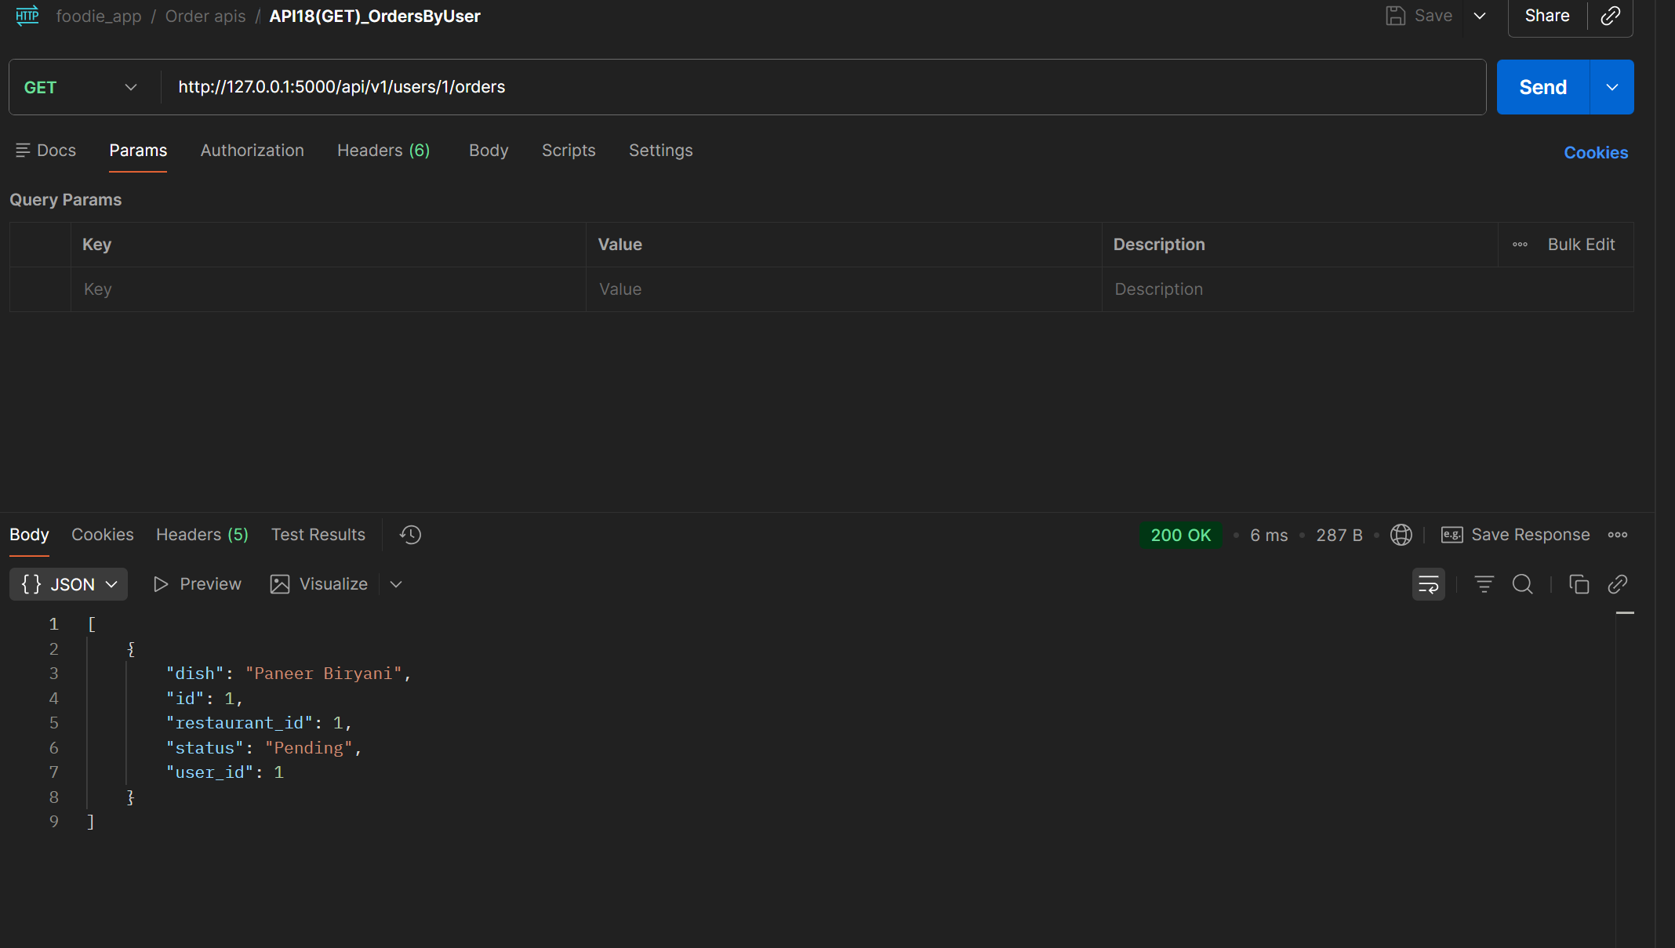
Project 3 — Postman | Order Module — API 18
GET /api/v1/users/{id}/orders → 200 |
📌 In Postman: send this request → screenshot the response panel → paste below | Badge colour: POST=Navy PUT=Gold GET=Green DELETE=Red
Order Module · APIs 17–18
API 18
screenshot placeholder
GET
/api/v1/users/{id}/orders
Expected Status:
200
Description
List all orders placed by a specific user
📷
What to verify in Postman:
Status code returns 200
[ Replace with actual screenshot ]
Response body contains expected JSON fields
Request body / params are correctly structured
Error cases: send missing fields → expect 400
Postman — API 18: GET /api/v1/users/{id}/orders
Shows: request body · response JSON · status 200 · response time
IIHT | WIPRO FEB 2026 | CAPSTONE PROJECT — Project 3: Foodie App API

Slide 51
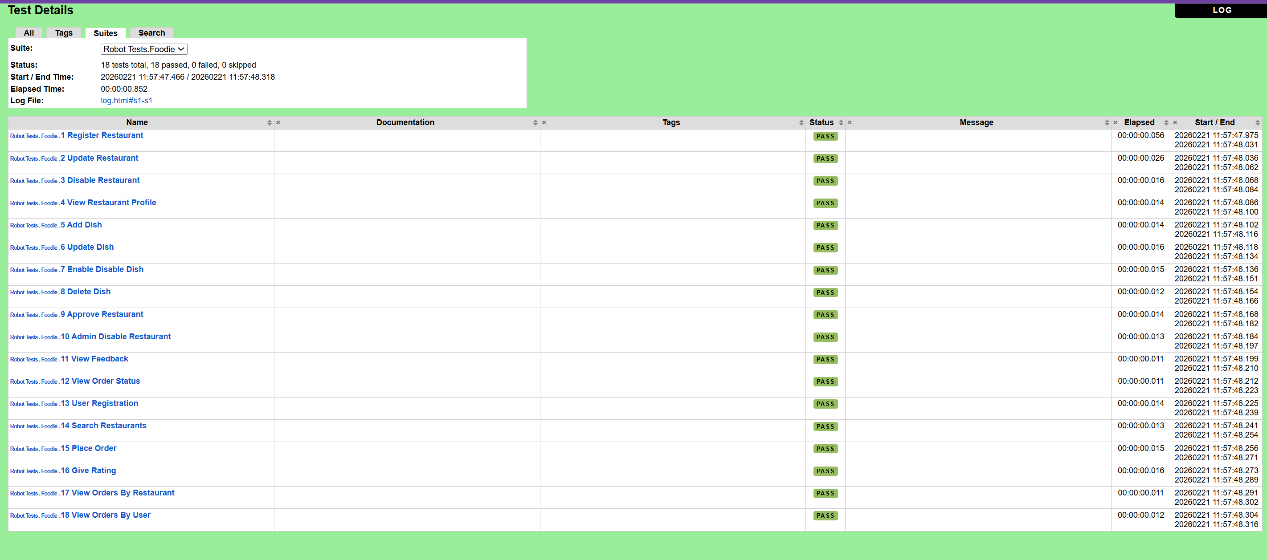
Project 3 — Robot Framework | Foodie API Log Report
foodie.robot execution log screenshot — shows all 18 test cases Status Should Be results
📌 Run: robot robot_tests/foodie.robot → open reports/log.html → screenshot → paste below
RF foodie.robot
screenshot placeholder
📷
[ Replace with actual screenshot ]
Robot Framework — Foodie API Log Report (log.html)
Shows: 18 test cases · Create Session · Status Should Be · Pass/Fail per request · Timestamps
IIHT | WIPRO FEB 2026 | CAPSTONE PROJECT — Project 3: Foodie App API

Slide 52
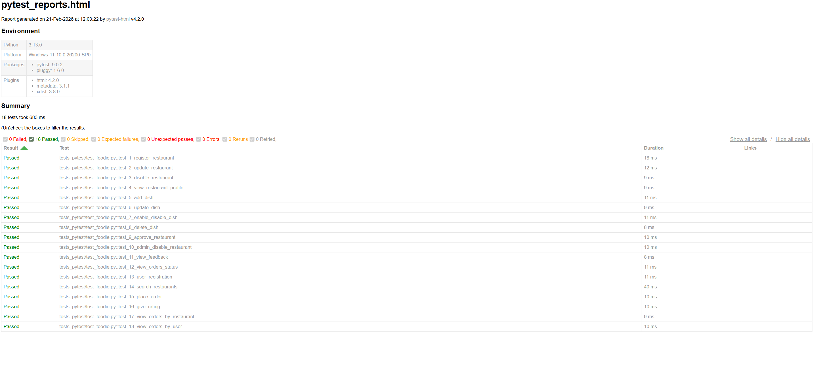
Project 3 — Pytest | Foodie API Log Report
Paste your test_foodie.py execution screenshot — shows all 18 pytest functions passed
📌 Run: pytest test_pytest/test_foodie.py -v → screenshot terminal or HTML report → paste below
Pytest foodie
screenshot placeholder
📷
[ Replace with actual screenshot ]
Pytest — Foodie API Test Log (test_foodie.py -v output)
Shows: 18 test functions · PASSED status · response status code assertions · run duration
IIHT | WIPRO FEB 2026 | CAPSTONE PROJECT — Project 3: Foodie App API

Slide 53
Project 3 — Challenges Faced
Foodie App API
Real problems we encountered and how we solved them
01
🌐
Flask Server Not Running — ConnectionRefusedError
02
🔗
In-Memory State — Test Order Dependency
⚠ Problem
⚠ Problem
When running Pytest or Robot Framework tests, requests were getting ConnectionRefusedError because the Flask server was not started before running the test suite.
Some tests like 'update restaurant' (API 2) depended on 'register restaurant' (API 1) having run first to create the resource. Running tests in isolation failed with 404.
✔ Solution
✔ Solution
Added a clear startup sequence: always run 'python app.py' in one terminal first, then run tests in another. Documented this as a prerequisite in the README.
Ordered test functions sequentially (test_1 to test_18) so each builds on the previous. Since Flask uses in-memory storage, data persists within the same server session.
03
📮
Postman — Wrong Content-Type Header
04
🤖
Robot Framework — RequestsLibrary Session Conflict
⚠ Problem
⚠ Problem
POST requests in Postman were returning 400 Bad Request even with correct data. The body was being sent as form-data instead of raw JSON.
Running all 18 test cases in one suite caused session conflicts because Create Session was called multiple times with the same alias 'foodie', raising a RuntimeError.
✔ Solution
✔ Solution
Changed Postman body type from 'form-data' to 'raw → JSON' and added Content-Type: application/json header. All POST and PUT requests then returned correct 201/200 responses.
Used 'Delete All Sessions' in Suite Teardown and structured the test file to call Create Session once in Suite Setup — shared across all 18 test cases cleanly.
IIHT | WIPRO FEB 2026 | CAPSTONE PROJECT — Project 3: Foodie App API

Slide 54
Conclusion — Project 3 — Foodie App REST API
API testing with three approaches: Postman (manual) · Pytest (automated) · Robot Framework (automated)
Foodie App REST API — Complete Automated Validation Achieved
Postman — Manual Testing
Pytest — Automated Testing
Robot Framework — Automated
Tested all 18 endpoints manually using Postman
18 test functions in test_foodie.py using requests library
18 test cases in foodie.robot using RequestsLibrary
Created 5 module collections: Restaurant, Dish, Admin, User, Order
Each function sends HTTP request and asserts status code
Create Session + POST/PUT/GET/DELETE On Session keywords
Verified request bodies, response JSON, and HTTP status codes
pytest -v output shows pass/fail for all 18 functions
Status Should Be validates each API response code
Validated error handling: 400 for missing fields, 404 for not found
Validates all 5 modules: Restaurant, Dish, Admin, User, Order
robot -d reports → auto-generates log.html with all results
Key Achievements:
18 REST endpoints validated · 5 feature modules covered · 3-layer testing (Manual + Pytest + RF) · All status codes verified · Reusable keyword-driven RF tests · Complete Postman collection
Overall Capstone Summary:
This capstone demonstrates end-to-end software testing proficiency — UI automation with Robot Framework (keyword-driven) and Pytest (POM-based), plus REST API automation with Pytest, Robot Framework, and Postman. All three projects follow industry best practices: data-driven testing, modular architecture, CI-ready execution, and comprehensive reporting.
IIHT | WIPRO FEB 2026 | CAPSTONE PROJECT — Project 3: Foodie App API

Slide 55
Thank You
Software Testing Capstone · Three Projects · One Team
3
29+
18
7
6
Complete
Projects
Total
Test Cases
REST API
Endpoints
Screenshot
Slides
Team
Members
IIHT | WIPRO FEB 2026 | CAPSTONE PROJECT

